Slide 1
The Cooper Union Retraining Program at CAMBA Introduction to Android Application Development
Instructor
Tavaris J. Thomas, Ph.D.

Slide 2
Welcome!
Learning Android – is a steep learning curve!
The purpose of this course is to introduce the student to android application development.
We will learn the primary aspects of the Android Operating System, Android SDK, and SDK Tools.
We will also study topics related to user interface, application services, permissions and security, device sensors, and data persistence.
By the end of 9 weeks you should have enough exposure to:
Write simple Android Applications
Understand What you’re writing

Slide 3
Course Outline
Your First Android Application
The Model-View-Controller (MVC)
The Activity Lifecycle
Debugging Android Apps
Your Second Activity
Layouts and Widgets
Audio Playback Using MediaPlayer
Background Services
Broadcast Intent

Slide 4
Prerequisites
You should be familiar with Java
Object-oriented programming at the very least
You should bring your own laptop to class each week.
Download and install the Android Studio from Google
http://developer.android.com/sdk/index.html
(please note if you are using and windows will not start you may need to install Java JDK)

Slide 5
Required Text:
Android Programming: The Big Nerd Ranch Guide (Big Nerd Ranch Guides) [3rd edition
Paperback]
Publisher: Big Nerd Ranch Guides
Language: English
ISBN-13: 978-0134706054
ISBN-10: 0134706056

Slide 6
What is Android ?
A “distribution” of Linux
8.0 Oreo API 26 Kernel 4.10
9.0 Pie API 28 latest
Bought from the Android company by Google in 2005
Apache License 2.0
Open Handset Alliance (founded by Google in 2007,
includes about 80+ companies)
Android versions are developed in relative secrecy by Google
Phone vendors port new versions to specific phones
Absolute minimum hardware(?): 340MB RAM (kernel) + 512MB flash(apps)

Slide 7
Android Architecture

Slide 8
What is Rooting an Android Phone?
Similar to “jailbreaking” in iPhone land.
Allows Linux superuser access
i.e can do just about anything
Allows more file-system access
Allows you to break things with terminal commands ☹

Slide 9
What is Developer Mode?
You can use any Android-powered device as an environment for running, debugging, and testing your applications.
This is known as developer mode
You can install your application on the device directly from android studio or from the command line with ADB. (android debug bridge)

Slide 10
What is Unlocking the Bootloader?
In literal terms, bootloader is code that is executed before any Operating System starts to run.
Bootloaders basically package the instructions to boot operating system kernel.
Android OS is an open source OS and is available on a variety of different hardware, every manufacturer has their own version of bootloader specific for the hardware present in it’s environment.
With a locked bootloader on Android devices, it is virtually impossible to flash a Custom ROM and forced attempts void warranty as well as usually end up in bricks. Therefore, the first step is to always unlock the bootloader.

Slide 11
Android Sharing and Security
Each app runs its own copy of the Dalvik VM
Copies of the Dalvik VM share some common memory (to reduce footprint)
Zygote is an always-running VM with all the core classes (for shared use)
Each app runs in its own user account
Each app runs in its own Linux process
Files are (by default) not shared between user accounts

Slide 12
READY? LET’S GET STARTED!!

Slide 13
Chapter 1
Your First Java Application

Slide 14
Android Studio
Download it from:
https://developer.android.com/studio/index.html

Slide 15
App Development Workflow Basics
Set up your workspace
Write your app
Build and Run
Debug, profile, and test
Publish

Slide 16
Hello World
https://developer.android.com/training/basics/firstapp/creating-project.html

Slide 17
Your First Second Java Application
Is Called GeoQuiz
Tests users knowledge of geography
This app consists of an activity
and its correpsonding layout activity_quiz.xml

Slide 18
GeoQuiz (Activity)
An activity is an instance of Activity, a class in the Android SDK. An activity is responsible for managing user interaction with a screen of information.
You write subclasses of Activity to implement the functionality that your app requires.
A simple app may need only one activity while complex ones have many.
GeoQuiz has single Activity subclass called QuizActivity

Slide 19
GeoQuiz(Layout)
A layout defines the set of user interface objects and their position on the screen.
A layout is made up definitions written in XML.
Each definition makes up an object you see on the screen.

Slide 20
Start a new Android Studio Project

Slide 21
Configuring your new project

Slide 22
Add an activity to Mobile
Highlight Blank Activity

Slide 23
Customize the Activity
Name the subclass MainActivity
Click Finish and Studio will create and launch into the project

Slide 24
Laying Out the User Interface
Text View
Linear layout
Linear layout
(horizontal)
Buttons

Slide 25
The View Hierarchy
Android:layout_width
Android:layout_height
Are required for nearly every Android widget.
Match_parent = view will be as big as parent
Wrap_content = view will be as big as content requires
Android:padding dp Density-independent Pixels - an abstract unit that is based on the physical density of the screen. These units are relative to a 160 dpi screen, so one dp is one pixel on a 160 dpi screen.
Android:orientation
Can be horizontal or vertical
Android:text
Refers to a string resource not literal string

Slide 26
From Layout XML to View Objects
String Resources
Every project includes a default strings named strings.xml
Res/values directory
<resources>
<string name="app_name">GeoQuiz</string>
<string name="question_text_view">The Pacific Ocean is larger than the Atlantic Ocean.</string>
<string name="true_button">True</string>
<string name="false_button">False</string>
<string name="correct_toast">Correct!</string>
<string name="incorrect_toast">Incorrect!</string>
<string name="menu_settings">Settings</string>
</resources>
GeoQuiz XML Elements become Android View Objects from the QuizActivity class
Src/QuizActivity.java

Slide 27
QuizActivity.java
QuizActivity is a subclass of Activity.
onCreate(Bundle) method is called when an instance of the activity subclass is created.
setContentView inflates a layout (sets a user interface xml file to an activity)

Slide 28
Resources and Resources IDs
A layout is a resource (aka a piece of your application that is not code)
To access a resource in code you user its resource ID
The resource ID for quiz_activity.xml is R.layout.activity_quiz
The gen directory contains current resource ID for your application
You can also generate resource IDs for your widgets by including android:id in your xml attributes
public static final class id {
public static final int false_button=0x7f070002;
public static final int menu_settings=0x7f070003;
public static final int question_text_view=0x7f070000;
public static final int true_button=0x7f070001;
}

Slide 29
Wiring Up Widgets
Once your widgets have generated resource IDs, you can access them in source code (.java files) e.g.
import android.widget.Button;
Button mTrueButton;
Button mFalseButton;
You can get a reference to inflated widget with findViewById
mTrueButton = (Button)findViewById(R.id.true_button);

Slide 30
Setting Listeners
Android applications are typically event driven.
A listener is an object that implements a listener interface for an event.
Many are built into Android
mTrueButton.setOnClickListener(new View.OnClickListener()
Listen for true button click event

Slide 31
Anonymous Inner Class
An anonymous inner class can come useful when making an instance of an object without having to actually subclass a class.
They are like local classes except that they do not have a name
new View.OnClickListener() {
@Override
public void onClick(View v) {
Toast.makeText(QuizActivity.this,
R.string.incorrect_toast, Toast.LENGTH_SHORT).show();
}
}
Because your anonymous class implements OnClickListener, it must implement that interfaces sole method onClick(View)

Slide 32
Let’s Toast
A toast is short message that informs the user of something but does not require any input or action.
Look at the toast code in previous slide for the onClick method.
See app demo in emulator.

Slide 33
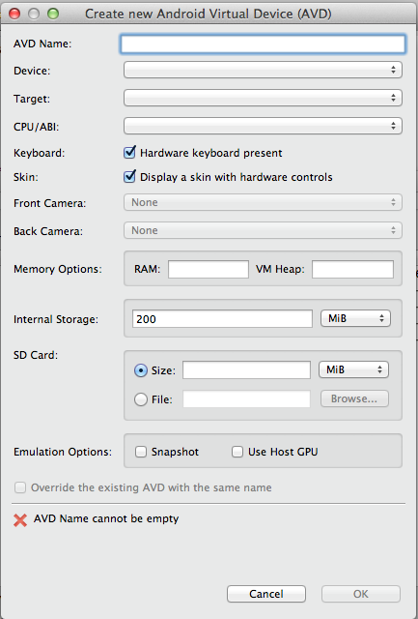
Run on the Emulator
Create a new AVD
Window->Android Virtual Device Manager
Click New…
Make sure you use Android 4.3 or earlier image

Slide 34
Android Build Tools
ADT provides command ways to build your app if you don’t use android studio.
Tools for automating android software build processes
The most popular are maven and ant.
Android update project –p
Ant debug
emulator -avd <name>
Adb install bin/blah blah blah.apk

