Slide 1
Chapter 2
The Model-View-Controller (MVC)

Slide 2
Chapter 2 Overview
Add additional questions to the GeoQuiz app.
By adding a class, named TrueFlase
An instance of this class will encapsulate a single true/false question
Then we will create an array of TrueFalse objects for QuizActivity to manage.

Slide 3
Create a New Class
File->New->Class
Name TrueFalse
Add two member variables and constructor
private int mQuestion;
// this variable will hold a resource ID for a string
//(always an int)
private boolean mTrueQuestion;
public TrueFalse(int question, boolean trueQuestion) {
mQuestion = question;
mTrueQuestion = trueQuestion;
}

Slide 4
Generating Getter and Setter Methods
On a Mac click ADT->Preferences
Java->Code Style
Make sure fields have “m” prefix
Make sure Use ‘is’ prefix for getters is checked
Why???
So Eclipse will auto generate
Correct methods for getters and
setters

Slide 5
Auto Generate
After constructor right click source->Generate Getters and Setters
Select the variables mQuestion and mTrueQuestion
public int getQuestion() {
return mQuestion;
}
public void setQuestion(int question) {
mQuestion = question;
}
public boolean isTrueQuestion() {
return mTrueQuestion;
}
public void setTrueQuestion(boolean trueQuestion) {
mTrueQuestion = trueQuestion;
}

Slide 6
Model View Controller and Android
Android applications are designed around an architecture called Model-View-Controller (MVC). An object in your applications is model object, a view object, or controller object.

Slide 7
MVC
Model object holds the applications data and business logic.
Model objects have no knowledge of the user interface.
Generally classes you create.
All of the model objects in your application compose its model layer. (e.g. TrueFalse class)
View objects know how to draw themselves on the screen and how to respond to user input.
Android provides many view classes.
You can also create custom views.
View object make up the view layer.
Controller objects tie model and view objects together.
Controllers are designed to respond to events
Contain application logic
Typically are a subclass of Activity, Fragment, or Service (e.g. QuizActivity)

Slide 8
User Input
User interacts with view object
Controller updates model objects
View sends message to controller
Views
Controller
Model
Controller updates View with changes in model objects
Controller takes data from model objects that its views are interested in

Slide 9
Updating the View Layer
Update activity_quiz.xml
Remove android:text attribute from TextView
Give TextView and android:id attribute to generate a resource ID
Add the new Button widget as a child of the root of LinearLayout

Slide 10
Updating the View Layer
Strings.xml
Activity_quiz.xml
<?xml version="1.0" encoding="utf-8"?>
<resources>
<string name="app_name">GeoQuiz</string>
<string name="true_button">True</string>
<string name="false_button">False</string>
<string name="next_button">Next</string>
<string name="prev_button">Prev</string>
<string name="correct_toast">Correct!</string>
<string name="incorrect_toast">Incorrect!</string>
<string name="menu_settings">Settings</string>
<string name="question_oceans">The Pacific Ocean is larger than the Atlantic Ocean.</string>
<string name="question_mideast">The Suez Canal connects the Red Sea and the Indian Ocean.</string>
<string name="question_africa">The source of the Nile River is in Egypt.</string>
<string name="question_americas">The Amazon River is the longest river in the Americas.</string>
<string name="question_asia">Lake Baikal is the world\'s oldest and deepest freshwater lake.</string>
</resources>
<LinearLayout xmlns:android="http://schemas.android.com/apk/res/android"
android:layout_width="match_parent"
android:layout_height="match_parent"
android:gravity="center"
android:orientation="vertical" >
<TextView
android:id="@+id/question_text_view"
android:layout_width="wrap_content"
android:layout_height="wrap_content"
android:padding="24dp" />
<LinearLayout
android:layout_width="wrap_content"
android:layout_height="wrap_content"
android:orientation="horizontal">
<Button
android:id="@+id/true_button"
android:layout_width="wrap_content"
android:layout_height="wrap_content"
android:text="@string/true_button" />
<Button
android:id="@+id/false_button"
android:layout_width="wrap_content"
android:layout_height="wrap_content"
android:text="@string/false_button" />
</LinearLayout>
<Button
android:id="@+id/next_button"
android:layout_width="wrap_content"
android:layout_height="wrap_content"
android:text="@string/next_button"
android:drawableRight="@drawable/arrow_right"
android:drawablePadding="4dp"
/>
</LinearLayout>

Slide 11
Updating the Controller Layer con’t
Add variables for TextView and a new Button and a TrueFalse array to QuizActivity.java
Button mNextButton;
TextView mQuestionTextView;
TrueFalse[] mAnswerKey = new TrueFalse[] {
new TrueFalse(R.string.question_oceans, true),
new TrueFalse(R.string.question_mideast, false),
new TrueFalse(R.string.question_africa, false),
new TrueFalse(R.string.question_americas, true),
new TrueFalse(R.string.question_asia, true)
};
int mCurrentIndex = 0;

Slide 12
Update the TextView
Set the text of the TextView object with the question at the current index.
super.onCreate(savedInstanceState);
setContentView(R.layout.activity_quiz);
mQuestionTextView = (TextView)findViewById(R.id.question_text_view);
int question = mAnswerKey[mCurrentIndex].getQuestion();
mQuestionTextView.setText(question);
…
mTrueButton = (Button)findViewById(R.id.true_button);

Slide 13
Update TextView via NextButton
mNextButton = (Button)findViewById(R.id.next_button);
mNextButton.setOnClickListener(new View.OnClickListener() {
@Override
public void onClick(View v) {
mCurrentIndex = (mCurrentIndex + 1) % mAnswerKey.length;
int question = mAnswerKey[mCurrentIndex].getQuestion();
mQuestionTextView.setText(question);
}
});

Slide 14
Move Repeated Code Into Function
mNextButton = (Button)findViewById(R.id.next_button);
mNextButton.setOnClickListener(new View.OnClickListener() {
@Override
public void onClick(View v) {
mCurrentIndex = (mCurrentIndex + 1) % mAnswerKey.length;
updateQuestion();
}
});
private void updateQuestion() {
int question = mAnswerKey[mCurrentIndex].getQuestion();
mQuestionTextView.setText(question);
}

Slide 15
Create a Check Answer Method
private void checkAnswer(boolean userPressedTrue) {
boolean answerIsTrue = mAnswerKey[mCurrentIndex].isTrueQuestion();
int messageResId = 0;
if (userPressedTrue == answerIsTrue) {
messageResId = R.string.correct_toast;
} else {
messageResId = R.string.incorrect_toast;
}
Toast.makeText(this, messageResId, Toast.LENGTH_SHORT)
.show();
}

Slide 16
Testing on a Real Device
Setup USB on the computer:
– Windows: Install an Android USB driver for the phone
– Mac: /* Do nothing */
– Linux: Add a rules file containing USB configuration info
Plug the device into the computer
You can see if ADT recognizes the device in the Device view in DDMS
If your device is not recognized try restarting ADB

Slide 17
Configuring Device for Development
On devices running Android 4.1 or earlier:
Open device Settings->Applications: check Unknown sources
On devices running Android 4.2 or newer:
Open device Settings->Security: check Unknown sources
Enable USB Debugging
On devices running earlier than Android 4.0:
Open device Settings->Applications->Development:
On devices running Android 4.0 or 4.1:
Open device Settings->Developer:
On devices running Android 4.2 or later:
Open device Settings->About->Tablet/Phone and Press Build number 7 times: then see step above

Slide 18
Run GeoQuiz (add resources)
Place images in the:
res/drawable-mdpi medium density screens (~160dpi)
res/drawable-hdpi high density screens (~240dpi)
res/drawable-xhdpi extra high density screens (~320dpi)

Slide 19
Screen Densities

Slide 20
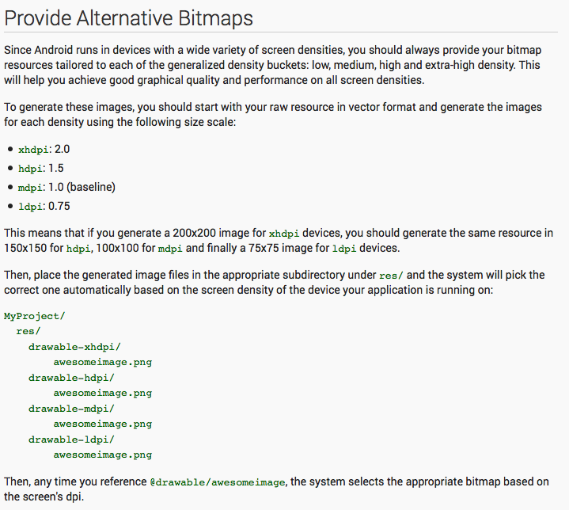

Slide 21
Challenges
Add a previous button to compliment the next button.
Add an image button

