Slide 1
Chapter 3
The Activity Lifecycle
Notes:
Please uncomment all lines of code from GeoQuiz 3 project and make sure you are using emulator 4.3 (Jelly Bean)

Slide 2
Pixel Densities
In production apps, it is important to provide images for the different screen pixel densities in your projects.
Providing different images will reduce artifacts from images being scaled up and down.
All of the images in your project will be installed with your app, and the OS will choose the best one for that specific device.

Slide 3
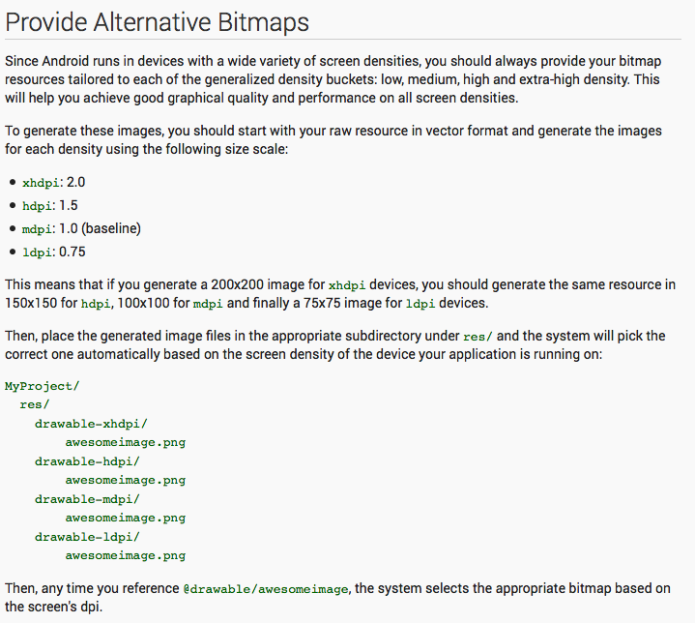

Slide 4
Screen Densities

Slide 5
The Activity Lifecycle
Every instance of Activity has a lifecycle.
3 possible states:
Running
Paused
Stopped
For each transition there is an Activity method that notifies the Activity of change of state.
You never call these methods directly yourself, you override them and the OS calls them at the appropriate time.

Slide 6
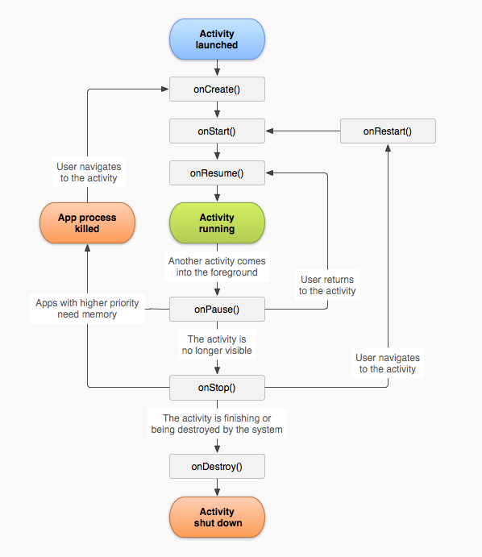

Slide 7
android.util.log
Android has its own logging mechanism.
android.util.log class used for shared system level messages.
You can log from anywhere in your code by calling Log.d(TAG, message), where TAG and message are some strings.
TAG should be a tag that is meaningful to you given your code.
Good practice is to define TAG as a Java constant for your entire class, such as:
E.g. private static final String TAG = “QuizActivity”;
E.g. then Call Log.d(TAG, “This an example of a log message”);

Slide 8
Override Lifecycle Methods
Add the log message shown (to the right) to each Activity Lifecycle Method
All lifecycle methods must call super class implementation of methods first.
@override makes the compiler verify that class has the method you are overriding
} // End of onCreate(Bundle) @Override
public void onStart() { super.onStart();
Log.d(TAG, "onStart() called");
}
@Override
public void onPause() { super.onPause();
Log.d(TAG, "onPause() called");
}
@Override
public void onResume() { super.onResume();
Log.d(TAG, "onResume() called");
}
@Override
public void onStop() { super.onStop();
Log.d(TAG, "onStop() called");
}
@Override
public void onDestroy() { super.onDestroy();
Log.d(TAG, "onDestroy() called"); } }

Slide 9
LogCat
The Android system log is outputted to LogCat, a standardized system-wide logging mechanism.
LogCat is readily available to all Java and C/C++ code.
The developer can easily view the logs and filter their output based on severity, such as debug, info, warning, or error, or based on custom-defined tags.
Two ways to view the LogCat: via android studio or via the command line.
In android studio select Android Monitor Window->LogCat
OR
From adb CLI

Slide 10
LogCat Command Line

Slide 11
android studio monitor with LogCat

Slide 12
Testing Activity Lifecycle
Run the sample code for GeoQuiz and view its logging statements.
Notice the log cat statements as you launch the app.
Click the back arrow of the android emulator. Notice how Android calls the other lifecycle methods for activity and eventually destroys the app. With onDestroy()

Slide 13
Rotating the Emulator
Rotating the device changes the device configuration.
Screen orientation
Screen density
Screen Size
Keyboard type
Dock mode
Language

Slide 14
Device Configurations and Resources
Typically your application should provide alternative resources depending on different device configurations.
An example of this were the different icons for arrows for pixel densities
Pixel densities are fixed and can not change during runtime
Screen orientation CAN change and is considered a runtime configuration change.

Slide 15
Create a Landscape Layout
Create a folder in the res/ called “layout-land” and place your layout XML files in there.
The “-land” suffix is configuration qualifier
Android recognizes different configuration qualifiers and others can be found at http://developer.android.com/guide/topics/resources/providing-resources.html
See Demo and android studio code

Slide 17
Saving Data Across Rotation
Android provides the onSaveInstanceState method to save runtime configuration changes.
protected void onSaveInstanceState(Bundle outState)
When screen orientation changes on the device Android automatically calls onPause(), onStop(), and onDestroy()
onSaveInstanceState() is normally called beforehand

Slide 18
Saving Data Across Rotation
State data is saved in the Bundle object
Bundle maps string keys to values
Values are only Java primitives and Objects that implement Serializable interface
You must call savedInstanceState.putInt(key,value);

Slide 19
Activity Lifecycle Revisted
Android never destroys a running activity to reclaim memory
When onSaveInstanceState is called Android takes the Bundle object used by app and uses it as an activity record.
When stashed the Activity object does not exist but the Bundle does.
OS can easily relaunch app with that information.
Back button also wipes activity record from app.

Slide 20
Logging Levels
Note that Log takes different severity levels.
.d() is for debug level
.e() for error
.w() for warning
.i() for info
There’s also a .wtf() severity level for errors that should never happen. (It stands for What a Terrible Failure ;)
android studio color-codes log messages based on their severity level.

