Slide 1
Chapter 5
Your Second Activity

Slide 2
Chapter 5 Overview
We will learn how to create a new activity and new layout without wizard
Start an activity from another activity
Pass data from the parent (starting) activity and child (started) activity

Slide 3
Setting up a second activity
Open strings.xml and the following:
<string name="cheat_button">Cheat!</string>
<string name="warning_text">Are you sure you want to do this?</string>
<string name="show_answer_button">Show Answer</string>
<string name="judgment_toast">Cheating is wrong.</string>

Slide 4
Create a new activity wizard
Choose New → Activity → Empty Activity,

Slide 5
Choose Empty Activity
Set Activity Name to CheatActivity. This is the name of your Activity subclass. Layout Name will be automatically set to activity_cheat. This will be the base name of the layout file the wizard creates.

Slide 6
Add the following code to layout
<?xml version="1.0" encoding="utf-8"?>
<LinearLayout xmlns:android="http://schemas.android.com/apk/res/android"
android:layout_width="match_parent"
android:layout_height="match_parent"
android:orientation="vertical"
android:gravity="center">
<TextView
android:layout_width="wrap_content"
android:layout_height="wrap_content"
android:padding="24dp"
android:text="@string/warning_text" />
<TextView
android:id="@+id/answerTextView"
android:layout_width="wrap_content"
android:layout_height="wrap_content"
android:padding="24dp" />
<Button
android:id="@+id/showAnswerButton"
android:layout_width="wrap_content"
android:layout_height="wrap_content"
android:text="@string/show_answer_button" />
</LinearLayout>

Slide 7
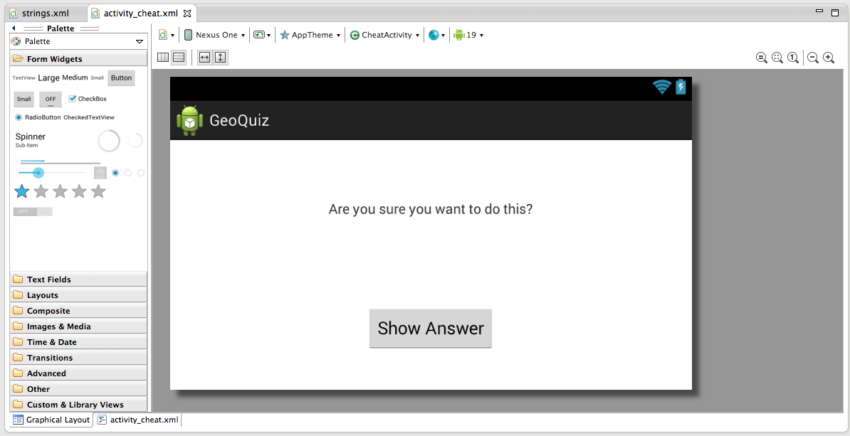
Preview activity_cheat.xml (landscape)

Slide 8
AndroidManifest.xml
The manifest file is an XML file containing metadata that describes your application to the Android OS
File is always named AndroidManifest.xml
Always in root dir of your application package
Every activity in your application must be declared in the manifest file.
You can specify the permissions your app should contain as it relates to the OS

Slide 9
Declare CheatActivity in the Manifest
<?xml version="1.0" encoding="utf-8"?>
<manifest xmlns:android="http://schemas.android.com/apk/res/android"
package="com.bignerdranch.android.geoquiz"
android:versionCode="1"
android:versionName="1.0" >
<uses-sdk
android:minSdkVersion="8"
android:targetSdkVersion="17" />
<application
android:allowBackup="true"
android:icon="@drawable/ic_launcher"
android:label="@string/app_name"
android:theme="@style/AppTheme" >
<activity
android:name="com.bignerdranch.android.geoquiz.QuizActivity"
android:label="@string/app_name" >
<intent-filter>
<action android:name="android.intent.action.MAIN" />
<category android:name="android.intent.category.LAUNCHER" />
</intent-filter>
</activity>
<activity
android:name=".CheatActivity"
android:label="@string/app_name" />
</application>
</manifest>

Slide 10
Declare CheatActivity in the Manifest
The wizard for the first activity of your application is automatically added to AndroidManifest.xml
Subsequent activities are not.
The android:name attribute is required, and the dot at the start of this attribute’s value tells the OS that this activity’s class is in the package specified in the package attribute in the manifest element at the top of the file. You will sometimes see a fully qualified android:name attribute, like android:name =" com.bignerdranch.android.geoquiz.CheatActivity".

Slide 11
Adding a Cheat Button to QuizActivity
Add the following code to layout/activity_quiz.xml
</LinearLayout>
<Button
android:id="@+id/cheat_button"
android:layout_width="wrap_content"
android:layout_height="wrap_content"
android:text="@string/cheat_button" />
<Button

Slide 12
Adding a Cheat Button to Landscape QuizActivity
Add the following code to layout-land/activity_quiz.xml
</LinearLayout>
<Button
android:id="@+id/cheat_button"
android:layout_width="wrap_content"
android:layout_height="wrap_content"
android:layout_gravity="bottom|center"
android:text="@string/cheat_button" />
<Button

Slide 13
Code the Cheat Button in QuizActivity.java
Add a variable, get a reference, and set View.onClickListener
…
Button mCheatButton;
…
@Override
protected void onCreate(Bundle savedInstanceState) {
…
mCheatButton = (Button)findViewById(R.id.cheat_button);
mCheatButton.setOnClickListener(new View.OnClickListener() {
@Override
public void onClick(View v) {
//start new (cheat) activity here
}
});

Slide 14
Starting an Activity
Call is sent to OS
Activity Manager creates an Activity instance and calls its onCreate() method
You can start an activity with the call
public void startActivty(Intent intent) method
Your Application
Android OS
Activity
Activity Manager
startActivity(Intent)
?

Slide 15
Communicating with Intents
Pass an intent as a parameter to startActivity to tell the Activity Manager which activity to start.
An intent is an object that a component can use to communicate with the OS
Your apps can also use services, broadcast receivers, and content providers.
A unique aspect of the Android system design is that any app can start another app’s component.

Slide 16
Android App Components
App components are the essential building blocks of an Android app.
There are four different types of app components. Each type serves a distinct purpose and has a distinct lifecycle that defines how the component is created and destroyed
Each component is a different point through which the system can enter your app. Not all components are actual entry points for the user and some depend on each other, but each one exists as its own entity and plays a specific role—each one is a unique building block that helps define your app's overall behavior.

Slide 17
Services
A service is a component that runs in the background to perform long-running operations or to perform work for remote processes.
A service does not provide a user interface.
For example, a service might play music in the background while the user is in a different app, or it might fetch data over the network without blocking user interaction with an activity.
Another component, such as an activity, can start the service and let it run or bind to it in order to interact with it.

Slide 18
Content Providers
Content providers - A content provider manages a shared set of app data. You can store the data in the file system, an SQLite database, on the web, or any other persistent storage location your app can access.
Through the content provider, other apps can query or even modify the data (if the content provider allows it).

Slide 19
Content Providers
For example, the Android system provides a content provider that manages the user's contact information. As such, any app with the proper permissions can query part of the content to read and write information about a particular person.

Slide 20
Broadcast Recievers
Broadcast receivers A broadcast receiver is a component that responds to system-wide broadcast announcements.
Many broadcasts originate from the system—for example, a broadcast announcing that the screen has turned off, the battery is low, or a picture was captured.
Apps can also initiate broadcasts—for example, to let other apps know that some data has been downloaded to the device and is available for them to use.

Slide 21
Broadcast Receivers
Although broadcast receivers don't display a user interface
(they may create a status bar notification to alert the user when a broadcast event occurs.)
More commonly, though, a broadcast receiver is just a "gateway" to other components and is intended to do a very minimal amount of work.
For instance, it might initiate a service to perform some work based on the event. A broadcast receiver is implemented as a subclass of BroadcastReceiver and each broadcast is delivered as an Intent object.

Slide 22
Communicating with Intents
GeoQuiz
Android OS
QuizActivity
Activity Manager
startActivity(…)
Intent
Component=cheatActivity
(Intent)
CheatActivity

Slide 23
Communicating with Intents
public Intent(Context packageContext, Class<?> cls)
Use the above constructor when creating the Intent
The Class object specifies which activity the Activity Manager should start
The Context object specifies which package the Class object is found in.
@Override
public void onClick(View v) {
Intent i = new Intent(QuizActivity.this, CheatActivity.class);
startActivity(i);
}
});
The Activity Manager checks the Android Manifest for a declaration as the same name as specified in the Intent
If not found will throw ActivityNotFoundException()
Note – you can open Activities within your own applicationi (explicit) and you can open them across applications (implicit)

Slide 24
Passing Data Between Activities
QuizActivity informs CheatActivity what the answer is
Whether the answer is true
QuizActivity
CheatActivity
Whether the user cheated

Slide 25
Explicit vs Implicit Intents
When you create an Intent with a Context and a Class object, you are creating an explicit intent. You use explicit intents to start activities within your application.
When an activity in your application wants to start an activity in another application, you create an implicit intent. You will use implicit intents in Chapter 15 of book.

Slide 26
Using Intent Extras
Extras are arbitrary data that the calling activity can include with an intent
To add an extra to an intent you have to call Intent putExtra(String name, boolean value)
The String parameter is always the key with some “value” whose type varies
@Override
public void onClick(View v) {
Intent i = new Intent(QuizActivity.this, CheatActivity.class);
boolean answerIsTrue = mAnswerKey[mCurrentIndex].isTrueQuestion();
i.putExtra(CheatActivity.EXTRA_ANSWER_IS_TRUE, answerIsTrue);
startActivity(i);
}
});
An activity may be started from different location so define keys for activities that actually define keys for extras on activities that retrieve them and use them.
Extra “Key” String

Slide 27
Retrieving Intent Extras
In CheatActivity ( the Activity receiving the data passed to it from the QuizAcitivty) use:
public boolean getBooleanExtra(String name, boolean defaultValue);
boolean mAnswerIsTrue;
mAnswerIsTrue = getIntent().getBooleanExtra(EXTRA_ANSWER_IS_TRUE, false);
Activity.getIntent() returns the Intent object that was fowarded in startActivity(intent)
To retrieve the value from the extra, you will use
public boolean getBooleanExtra(String name, boolean defaultValue)
The first argument is the name of the extra. The second argument of getBooleanExtra(…) is adefault answer if the key is not found.
Extra “Key” String

Slide 28
Enable Cheat Code and Test it (emulator)
TextView mAnswerTextView;
Button mShowAnswer;
…
mAnswerIsTrue = getIntent().getBooleanExtra(EXTRA_ANSWER_IS_TRUE, false);
mAnswerTextView = (TextView)findViewById(R.id.answerTextView);
mShowAnswer = (Button)findViewById(R.id.showAnswerButton);
mShowAnswer.setOnClickListener(new View.OnClickListener() {
@Override
public void onClick(View v) {
if (mAnswerIsTrue) {
mAnswerTextView.setText(R.string.true_button);
} else {
mAnswerTextView.setText(R.string.false_button);
}
setAnswerShownResult(true);
}
});
}

Slide 29
Getting Results Back from Child Activity
public void startActivityForResult(Intent intent, int requestCode)
The first parameter is the same intent as before. The second parameter is the request code.
The request code is a user-defined integer that is sent to the child activity and then received back by the parent.
It is used when an activity starts more than one type of child activity and needs to tell who is reporting back.

Slide 30
Gertting Results Back from Child Activity Cont
In QuizActivity, modify mCheatButton’s listener to call
startActivityForResult(Intent, int).(see page 104 of text book)
There are two methods you can call in the child activity to send data back to the parent:
public final void setResult(int resultCode)
public final void setResult(int resultCode, Intent data)

Slide 31
Setting the Result
When an activity exits, it can call setResult(int) to return data back to its parent.
It must always supply a result code, which can be the standard results RESULT_CANCELED, RESULT_OK, or any custom values starting at RESULT_FIRST_USER.
In addition, it can optionally return back an Intent containing any additional data it wants. All of this information appears back on the parent's Activity.onActivityResult(), along with the integer identifier it originally supplied.
If a child activity fails for any reason (such as crashing), the parent activity will receive a result with the code RESULT_CANCELED.

Slide 32
Setting a Result w/ Intent
In CheatActivity, add a constant for the extra’s key and a private method that creates an intent,puts an extra on it, and sets a result.
Then call this method in the Show Answer button’s listener.
(see code example page 106 of book)

Slide 33
Handling the Result

Slide 34
Handling the Result
In QuizActivity.java, add a new member variable to hold the value that CheatActivity is passing back.
Then override onActivityResult(…) to retrieve it.
(see page 109 of the book)

Slide 35
How Android Sees Your Activities
First, when you click on the GeoQuiz app in the launcher, the OS does not start the application; it starts an activity in the application.
More specifically, it starts the application’s launcher activity. For GeoQuiz, QuizActivity is the launcher activity.
When the template created the GeoQuiz application and QuizActivity, it made QuizActivity the launcher activity by default. Launcher activity status is specified in the manifest by the intent-filter element in QuizActivity’s declaration (Listing 5.17).
<action android:name="android.intent.action.MAIN" />
<category android:name="android.intent.category.LAUNCHER" />

Slide 36
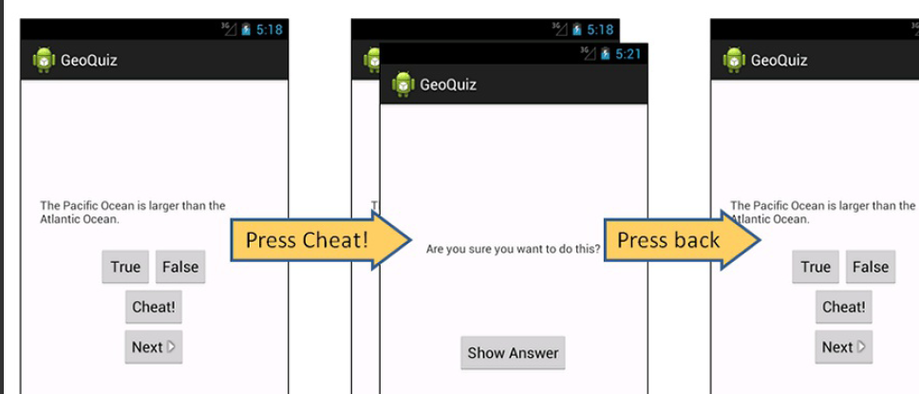

Slide 37
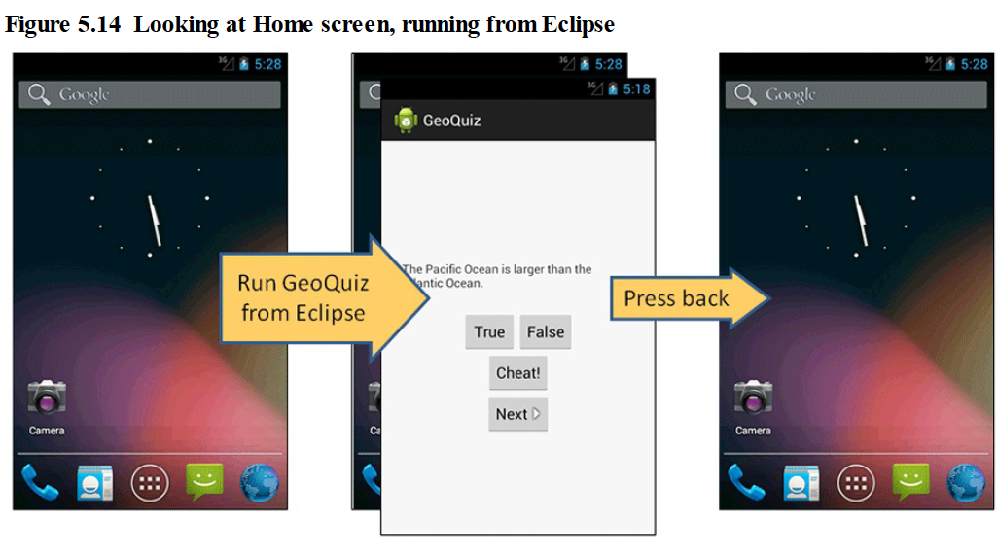

Slide 38
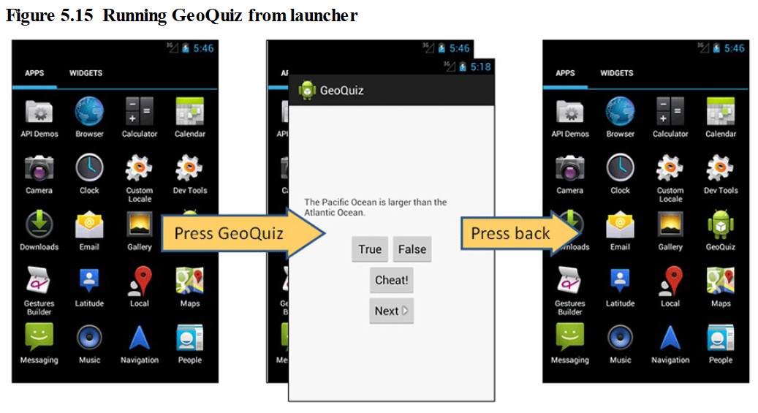

Slide 39
Challenges
Cheaters never win. Unless, of course, they persistently circumvent your anti-cheating measures. Which they probably will. Because they are cheaters.
GeoQuiz has a few major loopholes. For this challenge, you will busy yourself with closing them.
Here the loopholes are in ascending order, from easiest to hardest to close:
Users can rotate CheatActivity after they cheat to clear out the cheating result.
Once they get back, users can rotate QuizActivity to clear out mIsCheater.
Users can press Next until the question they cheated on comes back around.

Slide 40
Chapter 6
Android SDK Version and Compatibility

Slide 41
Android SDK Versions

Slide 42
Android SDK Versions
Each “codenamed” release is followed by incremental releases.
For instance, Ice Cream Sandwich was initially released as Android 4.0 (API level 14). It was almost immediately replaced with incremental releases culminating in Android 4.0.3 and 4.0.4 (API level 15).
The percentage of devices using each version changes constantly, of course, but the figures do reveal an important trend: Android devices running older versions are not immediately upgraded or replaced when a newer version is available.
Why do so many devices still run older versions of Android? Most of it has to do with heavy competition among Android device manufacturers and US carriers. Carriers want features and phones that no other network has.
Device manufacturers feel this pressure, too – all of their phones are based on the same OS, but they want to stand out from the competition. The combination of pressures from the market and the carriers means that there is a bewildering array of devices with proprietary, one-off modifications of Android.

Slide 43
Android Device and SDK

Slide 44
Compatibility and Android Programming
To reach a broad market, Android developers must create apps that perform well on devices running KitKat, Lollipop, Marshmallow, Nougat, and any more recent versions of Android, as well as on different device form factors.
In addition to the minimum supported version, you can also set the target version and the build version.
All of these properties are set in the build.gradle file in your app module.
The build version lives exclusively in this file.
The minimum SDK version and target SDK version are set in the build.gradle file, but are used to overwrite or set values in your AndroidManifest.xml.

Slide 45
Target Android Devices

Slide 46
build.gradle
apply plugin: 'com.android.application' android { compileSdkVersion 25 buildToolsVersion '25.0.2' defaultConfig { applicationId "com.bignerdranch.android.geoquiz" minSdkVersion 19 targetSdkVersion 25 versionCode 1 versionName "1.0" testInstrumentationRunner "android.support.test.runner.AndroidJUnitRunner" } buildTypes { release { minifyEnabled false proguardFiles getDefaultProguardFile('proguard-android.txt'), 'proguard-rules.pro' } } } dependencies { compile fileTree(dir: 'libs', include: ['*.jar']) androidTestCompile('com.android.support.test.espresso:espresso-core:2.2.2', { exclude group: 'com.android.support', module: 'support-annotations' }) compile 'com.android.support:appcompat-v7:25.3.0' testCompile 'junit:junit:4.12' }

Slide 47
Minimum sdk
The minSdkVersion value is a hard floor below which the OS should refuse to install the app.
For example - By setting this version to API level 19 (KitKat), you give Android permission to install GeoQuiz on devices running KitKat or higher.
Android will refuse to install GeoQuiz on a device running, say, Jelly Bean.

Slide 48
Target SDK
The targetSdkVersion value tells Android which API level your app is designed to run on. Most often this will be the latest Android release.
When would you lower the target SDK? New SDK releases can change how your app appears on a device or even how the OS behaves behind the scenes.
If you have already designed an app, you should confirm that it works as expected on new releases.

Slide 49
Compile SDK
This setting is not used to update the AndroidManifest.xml file.
Whereas the minimum and target SDK versions are placed in the manifest when you build your app to advertise those values to the OS, the compile SDK version is private information between you and the compiler.
Android’s features are exposed through the classes and methods in the SDK. The compile SDK version, or build target, specifies which version to use when building your own code.
You can modify the minimum SDK version, target SDK version, and compile SDK version in your build.gradle file, but note that modification of this file requires that you sync your project with the Gradle changes before they will be reflected.
To do this, select Tools → Android → Sync Project with Gradle Files. This will trigger a fresh build of your project with the updated values.

Slide 50
How to check build version of your app
if (Build.VERSION.SDK_INT >= Build.VERSION_CODES.LOLLIPOP) {
//do something…….
}

