Slide 1
Displaying Lists with Recycle View
Chapter 8

Slide 2
What are we covering?
CriminalIntent’s model layer currently consists of a single instance of Crime.
CriminalIntent’s model layer currently consists of a single instance of Crime. In this chapter, you will update CriminalIntent to work with a list of crimes. The list will display each Crime’s title and date.
Lets run app and see

Slide 3
Crime Lab Object
In the model layer, you have a new object, CrimeLab, that will be a centralized data stash that stores Crime objects.
Displaying a list of crimes requires a new activity and a new fragment in CriminalIntent’s controller layer: CrimeListActivity and CrimeListFragment.

Slide 4
MVC

Slide 5
MVC Cont’d
In the model layer, you have a new object, CrimeLab, that will be a centralized data stash for Crime objects.
Displaying a list of crimes requires a new activity and a new fragment in CriminalIntent’s controller layer: CrimeListActivity and CrimeListFragment.
CrimeActivity and CrimeaFragment are for details and not used in Chapter 9.
the view objects associated with CrimeListActivity and CrimeListFragment. The activity’s view will consist of a fragment-containing FrameLayout. The fragment’s view will consist of a RecyclerView.

Slide 6
Updating CriminalIntent’s Model Layer
You are going to store the list of crimes in a singleton.
A singleton is a class that allows only one instance of itself to be created.
A singleton exists as long as the application stays in memory, so storing the list in a singleton will keep the crime data available no matter what happens with activities, fragments, and their lifecycles.
Note , that with singleton classes, as they will be destroyed when Android removes your application from memory.

Slide 7
Singletons and Centralized Storage
To create a singleton, you create a class with a private constructor (static)and a get() method that returns the instance.
If the instance already exists, then get() simply returns the instance. If the instance does not exist yet, then get() will call the constructor to create it.

Slide 8
Singletons Con’t
The CrimeLab constructor requires a Context parameter. This is common in Android;
Having a Context parameter allows the singleton to start activities, access project resources, find your application’s private storage, and more.
Notice in get(Context) that you do not directly pass in the Context parameter to the constructor. This Context could be an Activity or another Context object, like Service.
You cannot be sure that just any Context will exist as long as CrimeLab needs it, which is for the life of the application.

Slide 9
What is a Context?
Its the context of current state of the application/object.
It lets newly created objects understand what has been going on.
Typically you call it to get information regarding another part of your program (activity, package/application)
The application context is a Context that is global to your application.

Slide 11
ArrayList
List < E > is an interface that supports an ordered list of objects of a given type. It defines methods for retrieving, adding, and deleting elements.
A commonly used implementation of List is ArrayList, which uses a regular Java array to store the list elements.
CrimeLab.java
mCrimes = new ArrayList < >();.

Slide 12
Abstract Activity for Hosting Fragment
activity_crime.xml is already generic
<? xml version =" 1.0" encoding =" utf-8"? > < FrameLayout xmlns:android =" http:// schemas.android.com/ apk/ res/ android" android:id ="@ + id/ fragment_container" android:layout_width =" match_parent" android:layout_height =" match_parent"
/>
Because activity_crime.xml does not name a particular fragment, you can use it for any activity hosting a single fragment. Rename it activity_fragment.xml to reflect its larger scope.

Slide 13
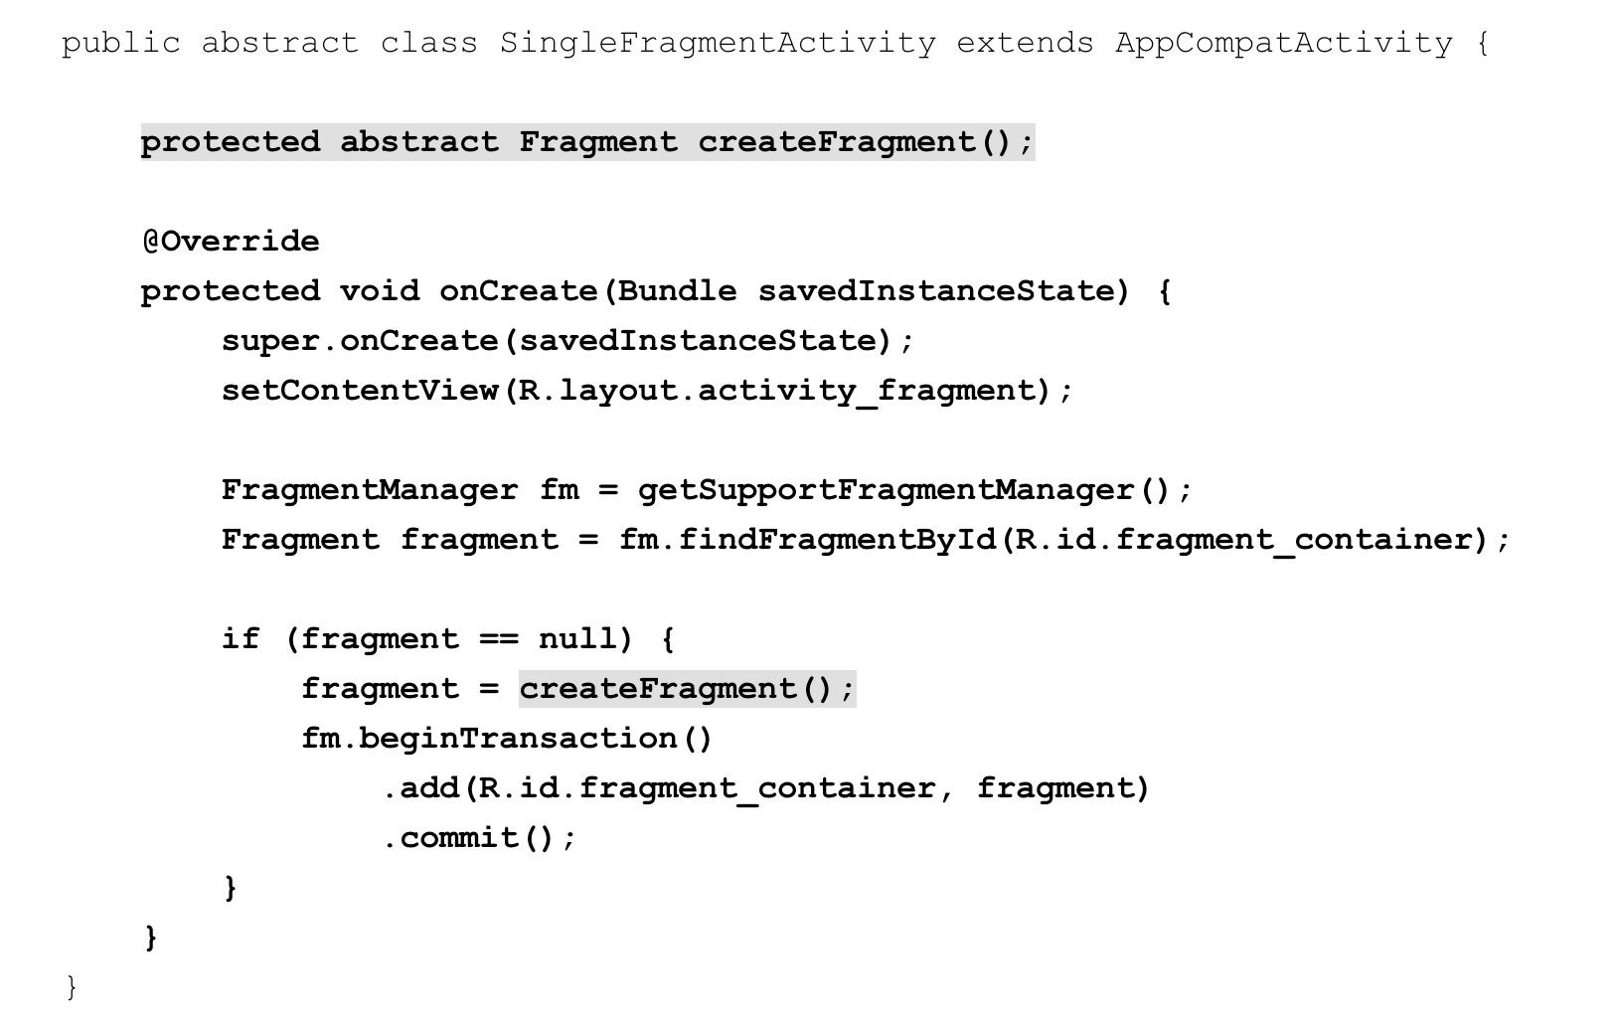
An abstract Activity class
To create the CrimeListActivity class, you could reuse CrimeActivity’s code.

Slide 14
Creating the new controllers
Now, you will create the two new controller classes: CrimeListActivity and CrimeListFragment.
Modify the new CrimeListActivity class to also subclass SingleFragmentActivity and implement the createFragment() method.

Slide 15
Declaring CrimeListActivity
If you have other methods in your CrimeListActivity, such as onCreate, remove them. Let SingleFragmentActivity do its job and keep CrimeListActivity simple.
Declaring CrimeListActivity as the launcher activity (AndroidManifest.xml)

Slide 16
RecyclerView, Adapter, and ViewHolder
Now, you want CrimeListFragment to display a list of crimes to the user. To do this, you will use a RecyclerView.
RecyclerView is a subclass of ViewGroup. It displays a list of child View objects, one for each item in your list of items. Depending on the complexity of what you need to display, these child Views can be complex or very simple. For your first implementation, each item in the list will display the title and date of a Crime. The View object on each row will be a LinearLayout containing two TextViews,

Slide 17
RecyclerView

Slide 18
View Holders and Adapters
The RecyclerView’s only responsibilities are recycling TextViews and positioning them onscreen.
To get the TextViews in the first place, it works with two classes that you will build in a moment: an Adapter subclass and a ViewHolder subclass.

Slide 19
ViewHolders
ViewHolder does one thing: It holds on to a View
itemView, a field that your superclass RecyclerView.ViewHolder assigns for you. The itemView field is your ViewHolder’s reason for existing: It holds a reference to the entire View you passed into super( view).

Slide 20
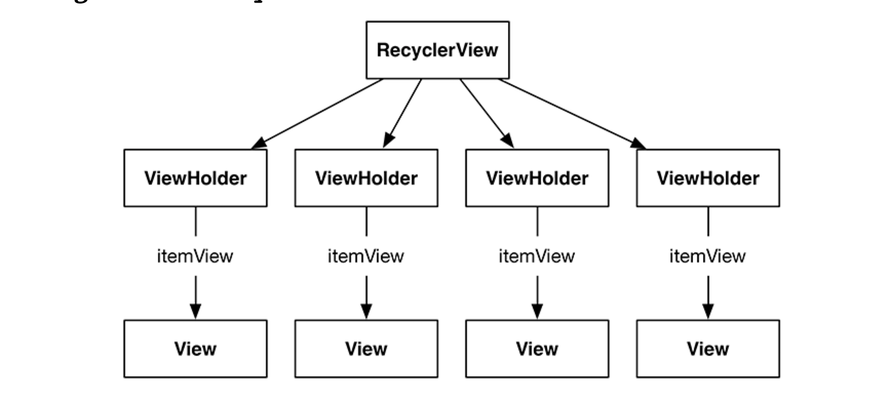

Slide 21
Adapters
RecyclerView does not create ViewHolders itself. Instead, it asks an adapter.
An adapter is a controller object that sits between the RecyclerView and the data set that the RecyclerView should display.
The adapter is responsible for: creating the necessary ViewHolders binding ViewHolders to data from the model layer.
When the RecyclerView needs a view object to display, it will have a conversation with its adapter.

Slide 22
RecyclerView Adapter
First, the RecyclerView asks how many objects are in the list by calling the adapter’s getItemCount() method.
.Then the RecyclerView calls the adapter’s onCreateViewHolder( ViewGroup, int) method to create a new ViewHolder, along with its juicy payload: a View to display.
Finally, the RecyclerView calls onBindViewHolder( ViewHolder, int). The RecyclerView will pass a ViewHolder into this method along with the position. The adapter will look up the model data for that position and bind it to the ViewHolder’s View.
To bind it, the adapter fills in the View to reflect the data in the model object.
Once enough ViewHolders have been created, RecyclerView stops calling onCreateViewHolder(…). Instead, it saves time and memory by recycling old ViewHolders.

Slide 24
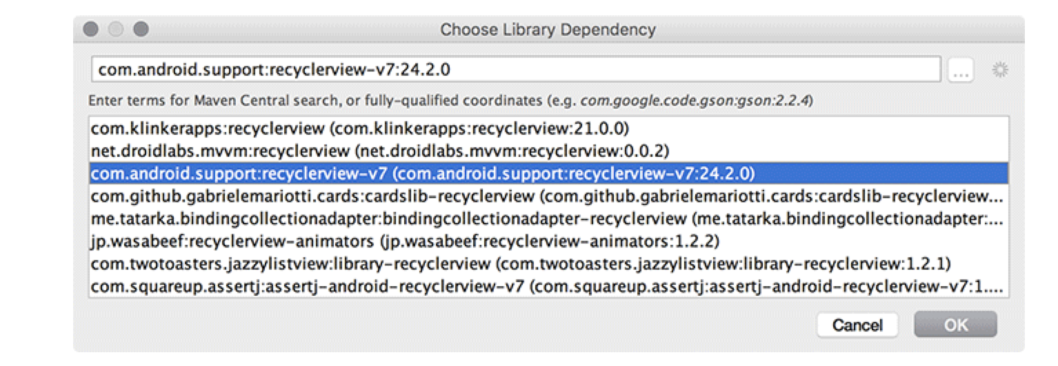
Using a Recycler View
Adding the RecyclerView dependency
Your RecyclerView will live in CrimeListFragment’s layout file. First, you must create the layout file.

Slide 25
RecyclerView to a layout file (fragment_crime_list.xml)

Slide 26
RecyclerView Cont
Note that as soon as you create your RecyclerView, you give it another object called a LayoutManager.
RecyclerView requires a LayoutManager to work. If you forget to give it one, it will crash.
onCreateViewHolder is called by the RecyclerView when it needs a new ViewHolder to display an item with.
In this method, you create a LayoutInflater and use it to construct a new CrimeHolder.

Slide 28
Binding List Items
Binding is taking Java code (like model data in a Crime, or click listeners) and hooking it up to a widget.
All the code that will do the real work of binding will go inside your CrimeHolder. That work starts with pulling out all the widgets you are interested in. This only needs to happen one time, so write this code in your constructor.
Your CrimeHolder will also need a bind( Crime) method. This will be called each time a new Crime should be displayed in your CrimeHolder.

Slide 29
Bind()
private class CrimeHolder extends RecyclerView.ViewHolder implements View.OnClickListener { private Crime mCrime; private TextView mTitleTextView; private TextView mDateTextView; public CrimeHolder(LayoutInflater inflater, ViewGroup parent) { super(inflater.inflate(R.layout.list_item_crime, parent, false)); itemView.setOnClickListener(this); mTitleTextView = (TextView) itemView.findViewById(R.id.crime_title); mDateTextView = (TextView) itemView.findViewById(R.id.crime_date); } public void bind(Crime crime) { mCrime = crime; mTitleTextView.setText(mCrime.getTitle()); mDateTextView.setText(mCrime.getDate().toString()); }

Slide 30
Calling bind()
(inside of ) private class CrimeAdapter extends RecyclerView.Adapter<CrimeHolder> {
@Override public void onBindViewHolder(CrimeHolder holder, int position) { Crime crime = mCrimes.get(position); holder.bind(crime); }

Slide 31
Responding to Presses
Handling touch events is mostly up to you. If you need them, RecyclerView can forward along raw touch events.
Instead, you can handle them like you normally do: by setting an OnClickListener. Since each View has an associated ViewHolder, you can make your ViewHolder the OnClickListener for its View.

Slide 32
Creating the list item layout
For CriminalIntent, a list item’s layout should include the crime’s title, its date, and whether the case has been solved.
This layout calls for two TextViews and a CheckBox.

Slide 33
Responding to Presses

Slide 34
Checkbox update
Under ordinary circumstances, you would now be ready to run.
However, because you have a CheckBox in your list item, there is one more change to make. A CheckBox is focusable by default.
This means that a click on a list item will be interpreted as toggling the CheckBox and will not reach your onListItemClick(…) method.
This internal quirk of ListView means that any focusable widget that appears in a list item layout (like a CheckBox or a Button) should be made non-focusable to ensure that a click on a list item will work as you expect.
Because your CheckBox only reports information and is not tied to any application logic, there is a simple solution. You can update list_item_crime.xml to define the CheckBox as not focusable.

