Slide 1
Audio Playback Using Media Player
Chapter 13

Slide 2
What will we cover?
This app will play a historical audio file using the MediaPlayer class.
MediaPlayer is the Android class for audio and video playback. It can play media from different sources (like a local file or streamed from the Internet) and in many different formats
(like WAV,MP3, Ogg Vorbis, MPEG-4, and 3GPP).

Slide 3
Create New Project
Use holo dark theme
Click Next. This app will not have a custom launcher icon. It will use the blank activity template.
Have the template create an activity named HelloMoonActivity.

Slide 4
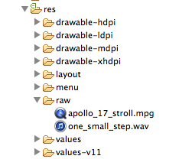
Adding Resources
HelloMoon requires an image file and an audio file that are available in the solutions file for this book
(http://www.bignerdranch.com/solutions/AndroidProgramming.zip).
Within the solutions, find the following files:
13_Audio/HelloMoon/res/drawable-mdpi/armstrong_on_moon.jpg
13_Audio/HelloMoon/res/raw/one_small_step.wav

Slide 5
Adding Resources Con’t
The audio file will be placed in the res/raw directory.
The raw directory is a catch-all for resources that do not need special handling from Android’s build system.
The res/raw directory is not created by default for a project, so you have to add it.
(Right-click the res directory and select New → Folder.) Then copy one_small_step.wav to the new directory.
(You can also copy 13_Audio/HelloMoon/res/raw/apollo_17_stroll.mpg into res/raw/. There is information and a challenge at the end of this chapter about playing video that will use this file.)

Slide 6
Adding Strings to strings.xml
See Listing 13.1
<?xml version="1.0" encoding="utf-8"?>
<resources>
<string name="app_name">HelloMoon</string>
<string name="hello_world">Hello world!</string>
<string name="menu_settings">Settings</string>
<string name="hellomoon_play">Play</string>
<string name="hellomoon_stop">Stop</string>
<string name="hellomoon_description">Neil Armstrong stepping
onto the moon</string>
</resources>

Slide 7
HelloMoon MVC
HelloMoon will have one activity, HelloMoonActivity, that hosts a HelloMoonFragment.
AudioPlayer is a class that you will write to encapsulate the MediaPlayer.
Encapsulating the MediaPlayer is not required;
you could have HelloMoonFragment interact directly with MediaPlayer. But this design helps keep your code nice and separate.

Slide 8
MVC

Slide 9
Set up the Fragment
Define a layout for the fragment
Create the fragment class
Modify the activity and its layout to host the fragment
Create a new Android XML layout file named fragment_hello_moon.xml.
Make its root element a TableLayout.

Slide 10
fragment_hello_moon.xml

Slide 11
Table Layout
TableLayout works a lot like a LinearLayout.
Instead of nesting LinearLayouts, you can arrange widgets using TableRows.
TableLayout and TableRow can team up to make it easier to arrange views in neat columns.
Here, TableLayout helps arrange your buttons side by side in equally sized columns.

Slide 12
Table Layout Con’t
See Android Studio for example
Notice that the TableRow widget does not have to declare height and width attributes.
It uses the TableLayout’s width and height as well as every other attribute of the TableLayout.
A nested LinearLayout, on the other hand, can offer more flexibility in how your widgets will appear.

Slide 13
Create Hello Moon Fragement
See Listing 13.3
Create a new class named HelloMoonFragment and make its superclass
android.support.v4.app.Fragment.
Override HelloMoonFragment.onCreateView(…) to inflate the layout you just defined and get references to the buttons.

Slide 14
Using Layout Fragment
In CriminalIntent, you have been hosting fragments by adding them in the activity’s code.
In HelloMoon, you are going to use a layout fragment instead.
When you use a layout fragment, you specify the fragment class in a fragment element.
See in Listing 13.4.
There is only one change that you need to make in HelloMoonActivity’s code before you can run the app.
Change HelloMoonActivity’s superclass to FragmentActivity.

Slide 15
Behind The Scenes
You named the fragment class in the layout and it was added to the activity and put on screen. Here is what happened behind the scenes.
When HelloMoonActivity called .setContentView(…) and inflated activity_hello_moon.xml, it found the fragment element.
At that point, the FragmentManager created an instance of HelloMoonFragment and added it to its list.
It then called HelloMoonFragment’s onCreateView(…) and placed the view that this method returns in the spot that the fragment tag was keeping warm.

Slide 16
Notice, This Is Different
What does this ease cost you? You lose the flexibility and power you get when explicitly working with the FragmentManager:
You can override the fragment’s lifecycle methods to respond to events, but you have no control over when these methods are called.
You cannot commit fragment transactions that remove, replace, or detach a layout fragment. You are stuck with what you have when the activity is created.
You cannot attach arguments to a layout fragment. Attaching arguments must be done after the fragment is created and before it is added to the FragmentManager.
With layout fragments, these events all happen out of your reach.

Slide 17
Welcome to Android Media Player
MediaPlayer class is used to control playback of audio/video files and streams.
Using MediaPlayer class we can control the behavior of player like volume control, whether to repeat the current track or not, stop or pause the playback etc.
Steps:
Initialize the Media Player with media to play.
Prepare the Media Player for playback.
Start the playback.
Pause or stop the playback prior to its completing.
Playback complete.

Slide 18
Welcome to Android Media Player
To play a media resource you need to create a new MediaPlayer object, initialize it with a media source, and prepare it for playback. When you have finished playing , call the release method on your Media Player object to free the resources associated with the MediaPlayer mediaPlayer.release();

Slide 19
Time For Audio Playback
Create a new class in the com.bignerdranch.android.hellomoon package named
AudioPlayer. Leave its superclass as java.lang.Object.
In AudioPlayer.java, add a member variable to hold an instance of MediaPlayer and methods to stop and play this instance.
See Listing 13.6 Simple playback code using MediaPlayer (AudioPlayer.java)

Slide 20
Preparing for Audio Playback
In the play(Context) method, you call MediaPlayer.create(Context, int).
MediaPlayer needs the Context to make sense of the audio file’s resource ID. (There are other MediaPlayer.create(…) methods to use if you are getting audio from somewhere else, like the Internet or a local URI.)
A resource identifier
A URI to a local file using the file
A URI to an online audio resource as a URL
A URI to a local Content Provider row
MediaPlayer filePlayer = MediaPlayer.create(appContext, Uri.parse("file:///sdcard/localfile.mp3")); MediaPlayer urlPlayer = MediaPlayer.create(appContext, Uri.parse("http://site.com/audio/audio.mp3")); MediaPlayer contentPlayer = MediaPlayer.create(appContext, Settings.System.DEFAULT_RINGTONE_URI) (ignore this for now)

Slide 21
Controlling the Playback
Skip for a particular time mediaPlayerObject.start(); int pos = mediaPlayerObject.getCurrentPosition(); int duration = mediaPlayerObject.getDuration(); mediaPlayerObject.seekTo(pos + (duration-pos)/10);

Slide 22
Repeating Audio Playback
We can use the isLooping and setLooping methods to specify if the media being played should repeat or loop when it completes. if (!mediaPlayer.isLooping()) mediaPlayer.setLooping(true);

Slide 23
Controlling Volume
We can also control the volume for each channel during playback using the setVolume method.
MediaPlayer’s basic set Volume is poor – I googled and found the following:
private final static int MAX_VOLUME = 100; ... ... final float volume = (float) (1 - (Math.log(MAX_VOLUME - soundVolume) / Math.log(MAX_VOLUME))); mediaPlayer.setVolume(volume, volume);

Slide 24
Audio Playback
In the play(Context) method, you call MediaPlayer.create(Context, int).
MediaPlayer needs the Context to make sense of the audio file’s resource ID. (There are other
MediaPlayer.create(…) methods to use if you are getting audio from somewhere else, like the Internet or a local URI.)
In AudioPlayer.stop(), you release the MediaPlayer and set mPlayer to null. Calling MediaPlayer.release() destroys the instance.

Slide 25
stop()
Destruction is an aggressive interpretation of “stop,” but there is good reason to be aggressive.
MediaPlayer will hold on to the audio decoder hardware and other system resources until you call release().
These resources are shared across all apps.
The MediaPlayer class includes a stop() method. It puts your MediaPlayer instance in a stopped state, from which it can
eventually be restarted.
However, in simple audio playback, it is better citizenship to destroy the instance with release() and then recreate it later.
So here is a simple rule: keep exactly one MediaPlayer around and keep it around only as long as it is playing something.

Slide 26
Releasing Audio
Calling stop() at the beginning of play(Context) prevents the creation of multiple instances of MediaPlayer if the user clicks the Play button twice.
Calling stop() when the file has finished playing releases your hold on the MediaPlayer instance as soon as you no longer need it.
You also need to call AudioPlayer.stop() in HelloMoonFragment to prevent the MediaPlayer from continuing playback after the fragment has been destroyed.
In HelloMoonFragment, override onDestroy() to call AudioPlayer.stop().

Slide 27
Wiring buttons to play and stop
Return to HelloMoonFragment.java and play some audio.
Create an instance of your AudioPlayer class and then set listeners on the buttons to play and stop.
See Listing 13.9 Hook up Play button (HelloMoonFragment.java)

Slide 28
Challenge 1
Challenge: Pausing Audio Playback
Give users the option to pause the audio playback. Head to the reference for the MediaPlayer class to find the methods you will need to implement pausing.

Slide 29
Challenge 2

Slide 30
How to Publish App on Google Play
1) Sign up for a Google developer account
https://play.google.com Cost $25 (one time fee)

Slide 31
Play.google.com

Slide 32
2. Create a merchant account

Slide 33
3. Create an App Entry

Slide 35
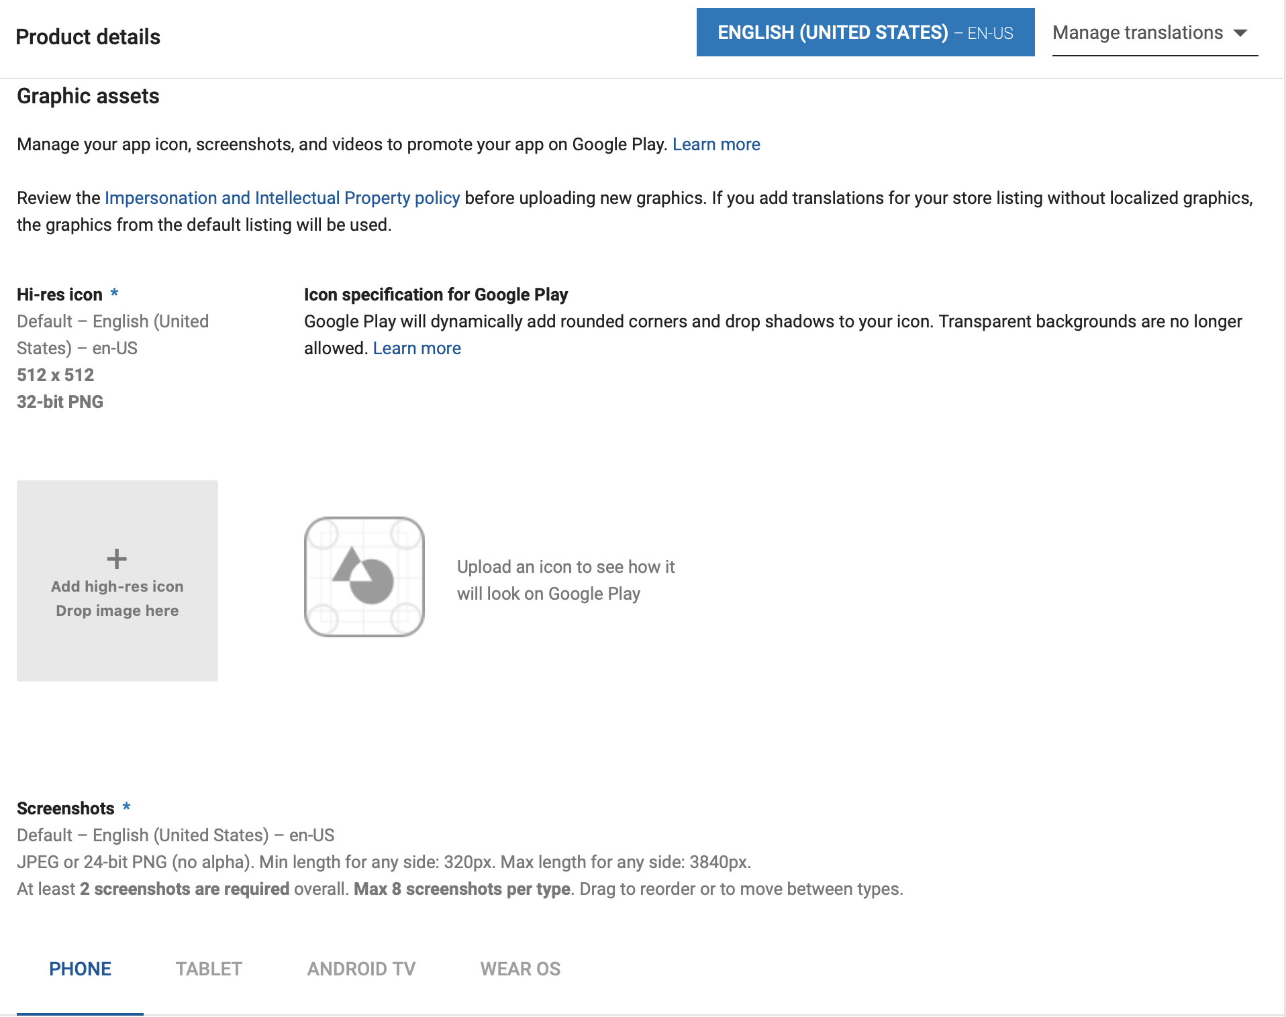

Slide 36
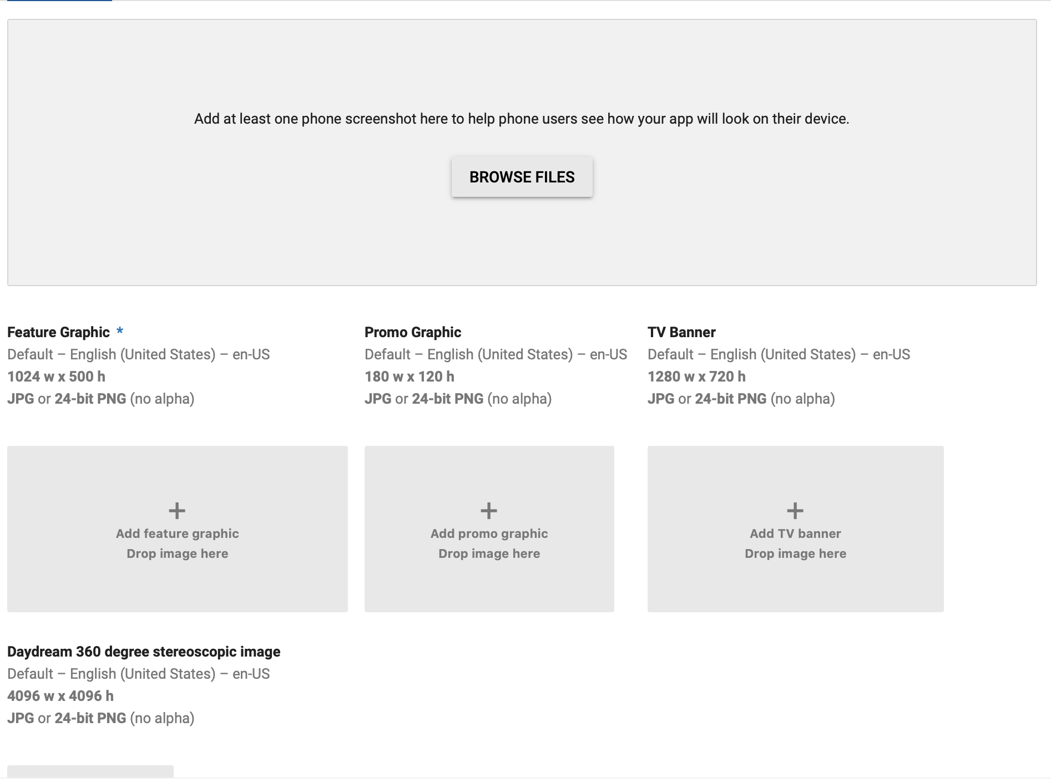

Slide 37
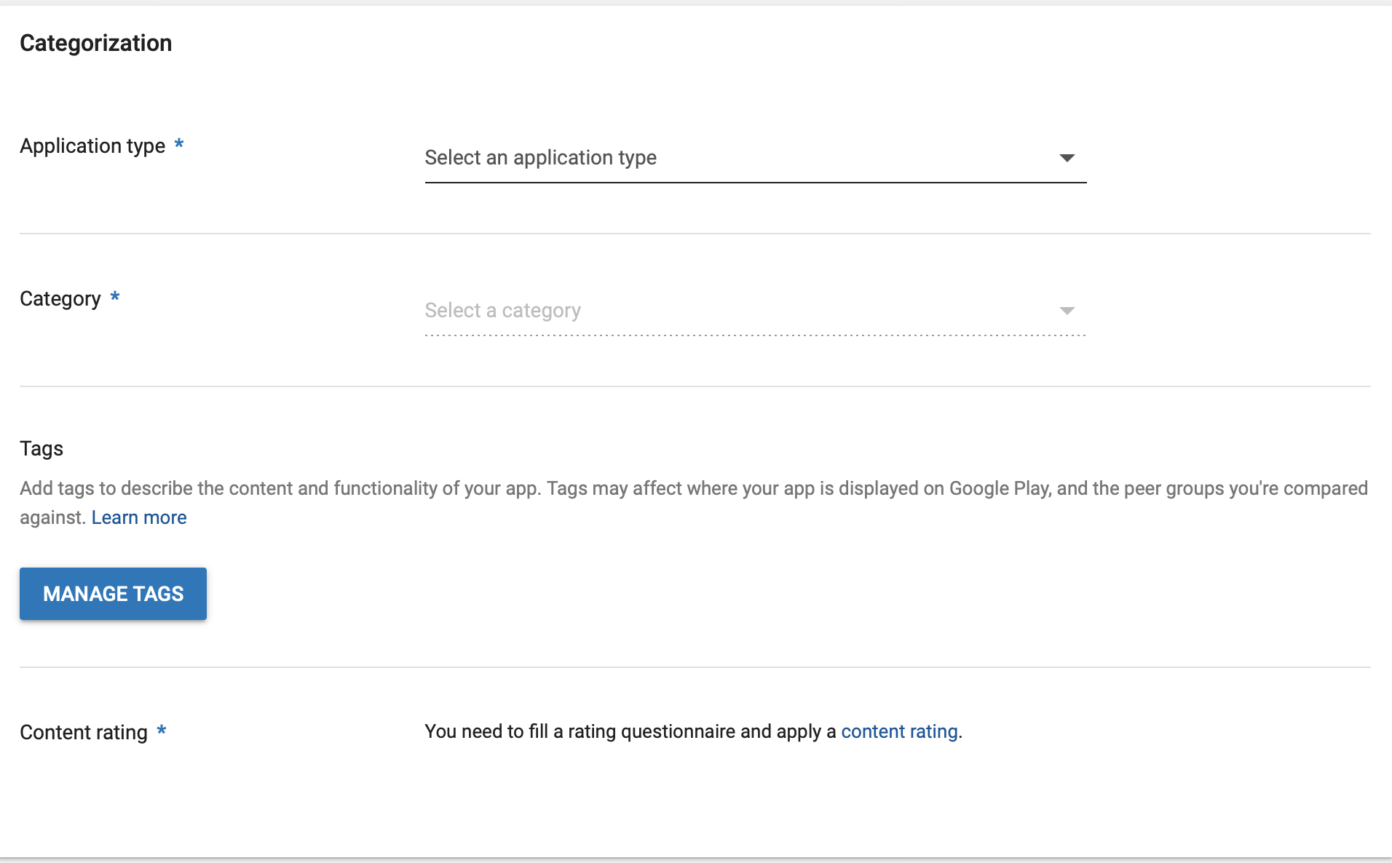

Slide 38
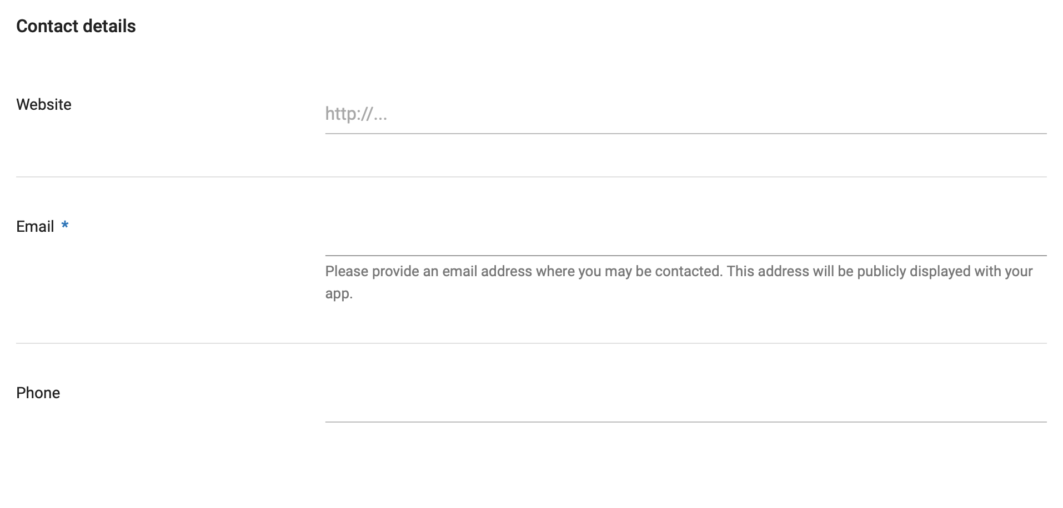

Slide 40
4. Generate Singed App Bundle

Slide 41
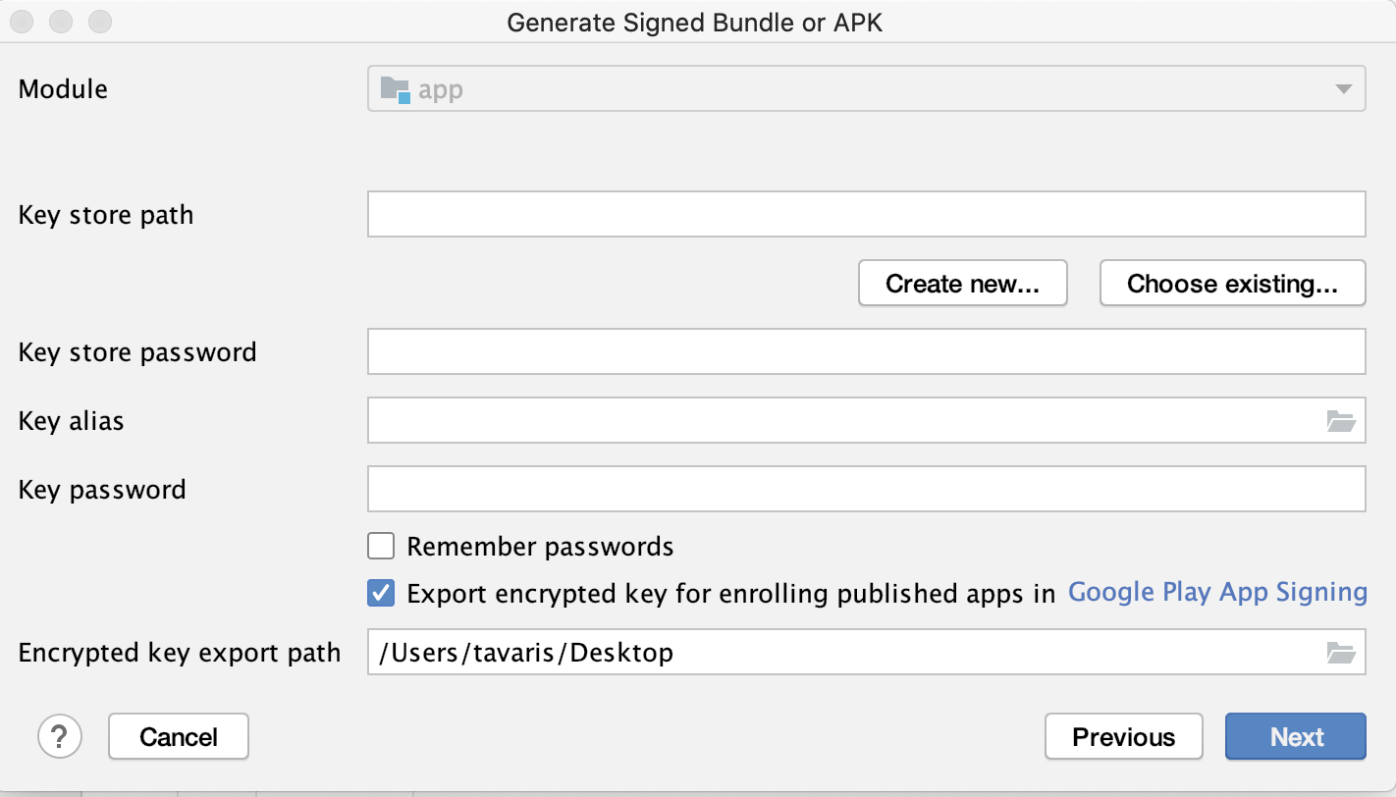

Slide 42
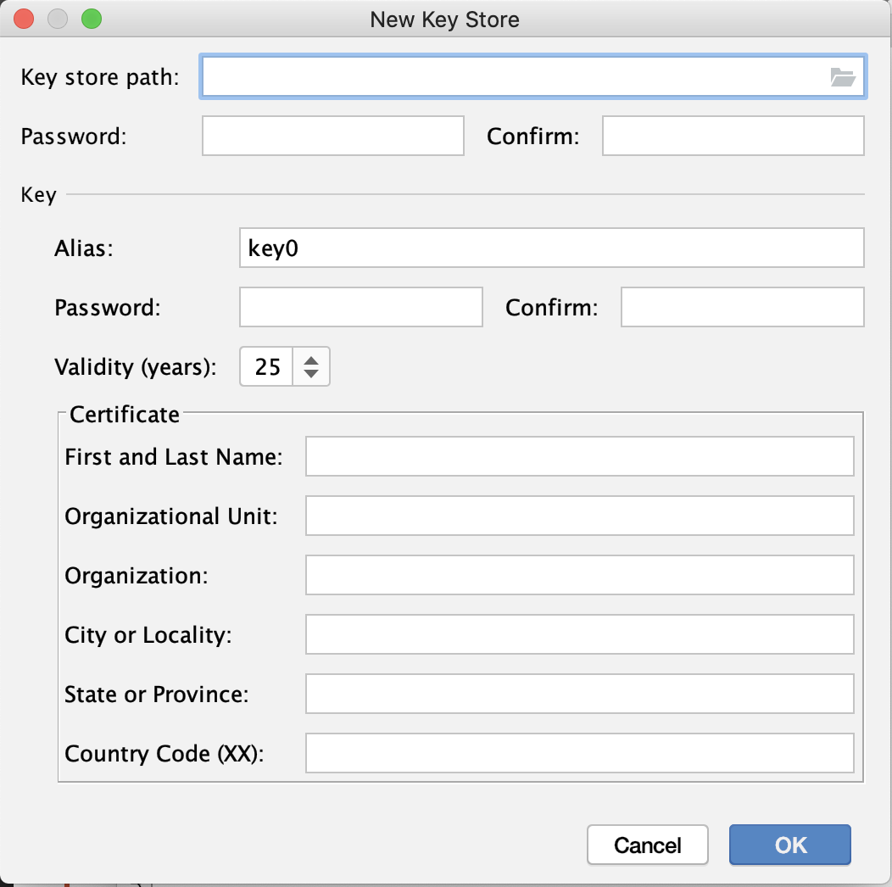

Slide 44
5. Upload your APK

