Slide 1
Chapter 24 and 26
Basic Networking, More with Intents &
Background Services

Slide 2
HTTPD and Basic Networking
Before we dive into services lets talk about networking
﻿The apps that dominate the brains of users are networked apps.
  Used for checking datafeeds, responding to text messages, or playing networked games.
To get look at a new app called PhotoGallery. PhotoGallery is a client for the photo-sharing site Flickr.
  It will fetch and display the most recent public photos uploaded to Flickr.
﻿In this chapter, you will learn how to use Android’s high-level HTTP networking. Almost all day-to-day programming of web services these days is based on the HTTP networking protocol.

Slide 3
Basic Networking
﻿You are going to have one class handle the networking in PhotoGallery.
Create a new Java class and, since you will be connecting to Flickr, name this class FlickrFetchr.
FlickrFetchr will start off small with only two methods:
  getUrlBytes(String)
  getUrlString(String).
The getUrlBytes(String) method fetches raw data from a URL and returns it as an array of bytes. The getUrlString(String) method converts the result from getUrlBytes(String) to a String.

Slide 4
Basic Networking
Look at ﻿Listing 25.3 Basic networking code (FlickrFetchr.java)
﻿This code creates a URL object from a string – like, say, https://www.bignerdranch.com.
Then it calls openConnection() to create a connection object pointed at the URL.
URL.openConnection() returns a URLConnection, but because you are connecting to an http URL, you can cast it to HttpURLConnection.
  This gives you HTTP-specific interfaces for working with request methods, response codes, streaming methods, and more.
HttpURLConnection represents a connection, but it will not actually connect to your endpoint until you call getInputStream() (or getOutputStream() for POST calls).
Once you create your URL and open a connection, you call read() repeatedly until your connection runs out of data. The InputStream will yield bytes as they are available. When you are done, you close it and spit out your ByteArrayOutputStream’s byte array.
While getUrlBytes(String) does the heavy lifting, getUrlString(String) is what you will actually use in this chapter. It converts the bytes fetched by getUrlBytes(String) into a String.

Slide 5
Basic Networking
﻿When a user tries to download an app, a dialog showing these permissions is displayed.
The user can then accept or deny installation. Android treats the INTERNET permission as not dangerous, since so many apps require it. As a result, all you need to do to use this permission is declare it in your manifest. More dangerous permissions (like the one allowing you to know the device’s location) also require a runtime request.

Slide 6
AsyncTask
﻿The next step is to call and test the networking code you just added. However, you cannot simply call FlickrFetchr.getUrlString(String) directly in PhotoGalleryFragment.
Instead, you need to create a background thread and run your code there. The easiest way to work with a background thread is with a utility class called AsyncTask, which creates a background thread for you and runs the code in the doInBackground(…) method on that thread.
Override AsyncTask.doInBackground(…) to get data from a website and log it.

Slide 7
Review Code
﻿Listing 25.5 Writing an AsyncTask, part I (PhotoGalleryFragment.java) public class PhotoGalleryFragment extends Fragment {
private static final String TAG = "PhotoGalleryFragment";
private RecyclerView mPhotoRecyclerView;
...
private class FetchItemsTask extends AsyncTask<Void,Void,Void> {
@Override
protected Void doInBackground(Void... params) {
try {
String result = new FlickrFetchr()
.getUrlString("https://www.bignerdranch.com");
Log.i(TAG, "Fetched contents of URL: " + result);
} catch (IOException ioe) {
Log.e(TAG, "Failed to fetch URL: ", ioe);
}
return null;
}
}
}
﻿
The call to execute() will start your AsyncTask, which will then fire up its background thread and call doInBackground(…). If you notice the Void… it just means running the AsyncTask without and parameters/arguments.

Slide 8
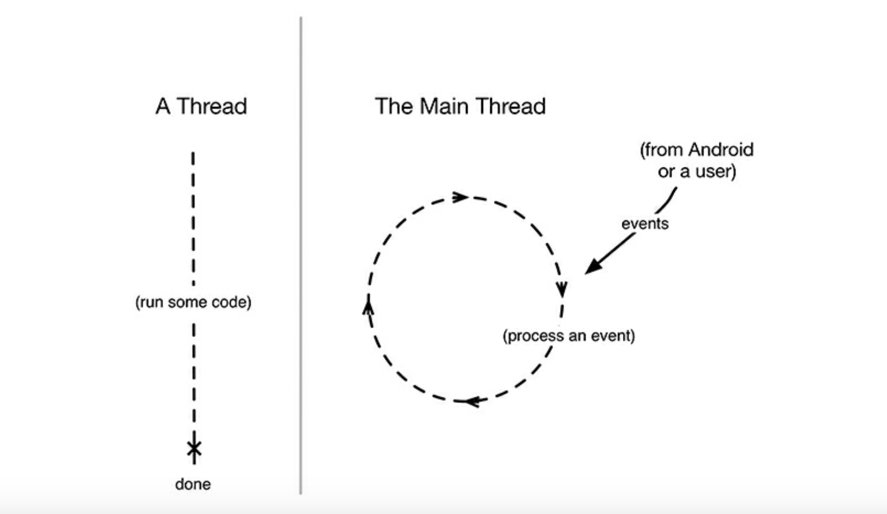
You and Your Main Thread
﻿Networking does not happen immediately. A web server may take as long as a second or two to respond, and a file download can take even longer than that. Because networking can take so long, Android disallows all networking on the main thread. If you try to do it, Android will throw a NetworkOnMainThreadException.
Why? To understand that, you need to understand what a thread is, what the main thread is, and what the main thread does. A thread is a single sequence of execution. Code running within a single thread will execute one step after another. Every Android app starts life with a main thread. The main thread, however, is not a preordained list of steps. Instead, it sits in an infinite loop and waits for events initiated by the user or the system. Then it executes code in response to those events as they occur
.

Slide 9
Not the Main Thread
﻿Networking is a lot like a phone call to your shoe distributor: It takes a long time compared to other tasks.
During that time, the UI will be completely unresponsive, which might result in an application not responding, or ANR.
An ANR occurs when Android’s watchdog determines that the main thread has failed to respond to an important event, like pressing the Back button.

Slide 10
Fetching JSON
﻿In Android, you do something similar – you create a background thread and access the network from there. And what is the easiest way to work with a background thread? Why, AsyncTask.
Representational State Transfer (REST) is an architectural style for creating, maintaining, retrieving, and deleting resources. REST's information-driven, resource-oriented approach to building Web service

Slide 11
JSON cont
﻿JSON stands for JavaScript Object Notation, a format that has become popular in recent years, particularly for web services.
Android includes the standard org.json package, which has classes that provide simple access to creating and parsing JSON text.
The Android developer documentation has information about org.json, and you can get more information about JSON as a format at json.org.
Flickr offers a fine JSON API. All the details you need are available in the documentation at www.flickr.com/services/api/. Pull it up in your favorite web browser and find the list of Request Formats. You will be using the simplest – REST. This tells you that the API endpoint is https://api.flickr.com/services/rest/.
You can invoke the methods Flickr provides on this endpoint.

Slide 12
Fetching JSON
﻿The only required parameter for the getRecent method is an API key. To get an API key, return to www.flickr.com/services/api/ and follow the link for API keys. You will need a Yahoo ID to log in. Once you are logged in, request a new, noncommercial API key. This usually only takes a moment. Your API key will look something like 4f721bgafa75bf6d2cb9af54f937bb70. (You do not need the “Secret,” which is only used when an app will access user-specific information or images.)

Slide 13
Fetching JSON
﻿Once you have a key, you have all you need to make a request to the Flickr web service. Your GET request URL will look something like this: https://api.flickr.com/services/rest/?method=flickr.photos.getRecent&api_key=xxx&format=json&nojsoncallback=1. The Flickr response is in XML format by default. To get a valid JSON response, you need to specify values for both the format and nojsoncallback parameters. Setting nojsoncallback to 1 tells Flickr to exclude the enclosing method name and parentheses from the response it sends back. This is necessary so that your Java code can more easily parse the response.

Slide 14
Fetching JSON
﻿Listing 25.8 Adding fetchItems() method (FlickrFetchr.java)
﻿Here you use a Uri.Builder to build the complete URL for your Flickr API request. Uri.Builder is a convenience class for creating properly escaped parameterized URLs. Uri.Builder.appendQueryParameter(String, String) will automatically escape query strings for you. Notice you added values for the method, api_key, format, and nojsoncallback parameters. You also specified one extra parameter called extras, with a value of url_s. Specifying the url_s extra tells Flickr to include the URL for the small version of the picture if it is available. Finally, modify the AsyncTask in PhotoGalleryFragment to call the new fetchItems() method.

Slide 15
Fetching JSON
﻿Listing 25.9 Calling fetchItems() method (FlickrFetchr.java)
public List<GalleryItem> fetchItems() {
List<GalleryItem> items = new ArrayList<>();
try {
String url = Uri.parse("https://api.flickr.com/services/rest/")
.buildUpon()
.appendQueryParameter("method", "flickr.photos.getRecent")
.appendQueryParameter("api_key", API_KEY)
.appendQueryParameter("format", "json")
.appendQueryParameter("nojsoncallback", "1")
.appendQueryParameter("extras", "url_s")
.build().toString();
String jsonString = getUrlString(url);
Log.i(TAG, "Received JSON: " + jsonString);
JSONObject jsonBody = new JSONObject(jsonString);
parseItems(items, jsonBody);
} catch (IOException ioe) {
Log.e(TAG, "Failed to fetch items", ioe);
} catch (JSONException je) {
Log.e(TAG, "Failed to parse JSON", je);
}

Slide 16
Fetching JSON
﻿Now that you have such fine JSON from Flickr, what should you do with it? You do what you do with all data – put it in one or more model objects. The model class you are going to create for PhotoGallery is called GalleryItem. Figure 25.10 shows an object diagram of PhotoGallery.
﻿Note that Figure 25.10 does not show the hosting activity so that it can focus on the fragment and the networking code.

Slide 17
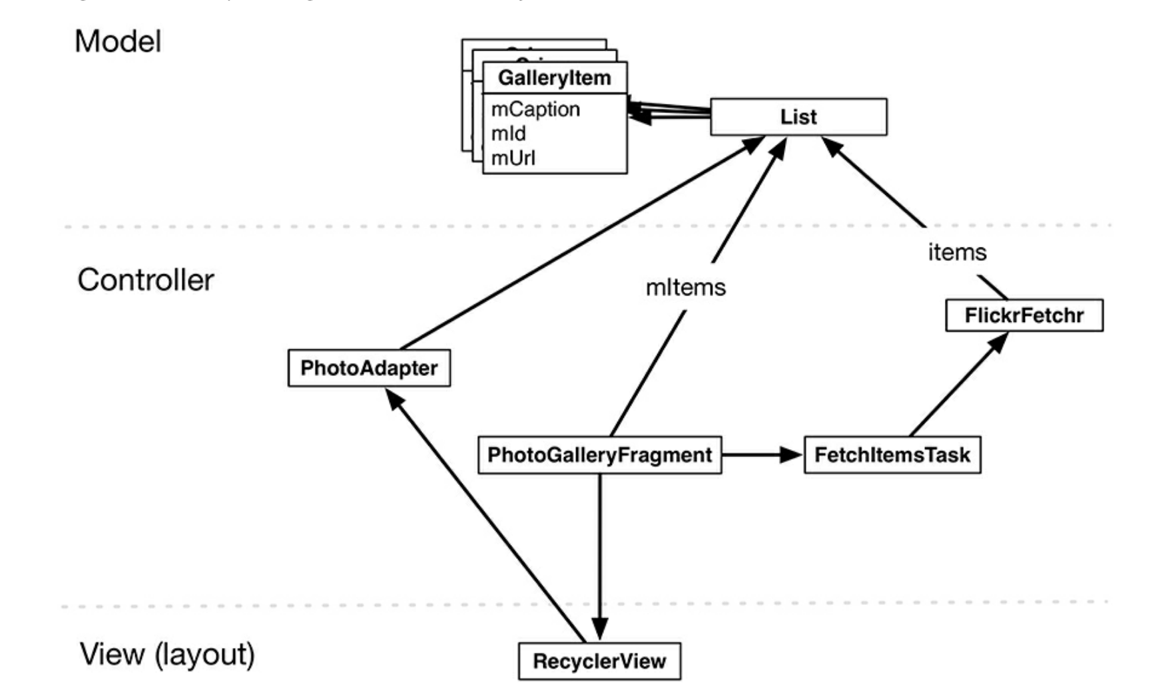

Slide 18
Parsing JSON
﻿The JSON response displayed in your browser and Logcat window is hard to read. If you pretty print (format with white space) the response, it looks something like Figure 25.11. Figure 25.11 JSON hierarchy

Slide 19
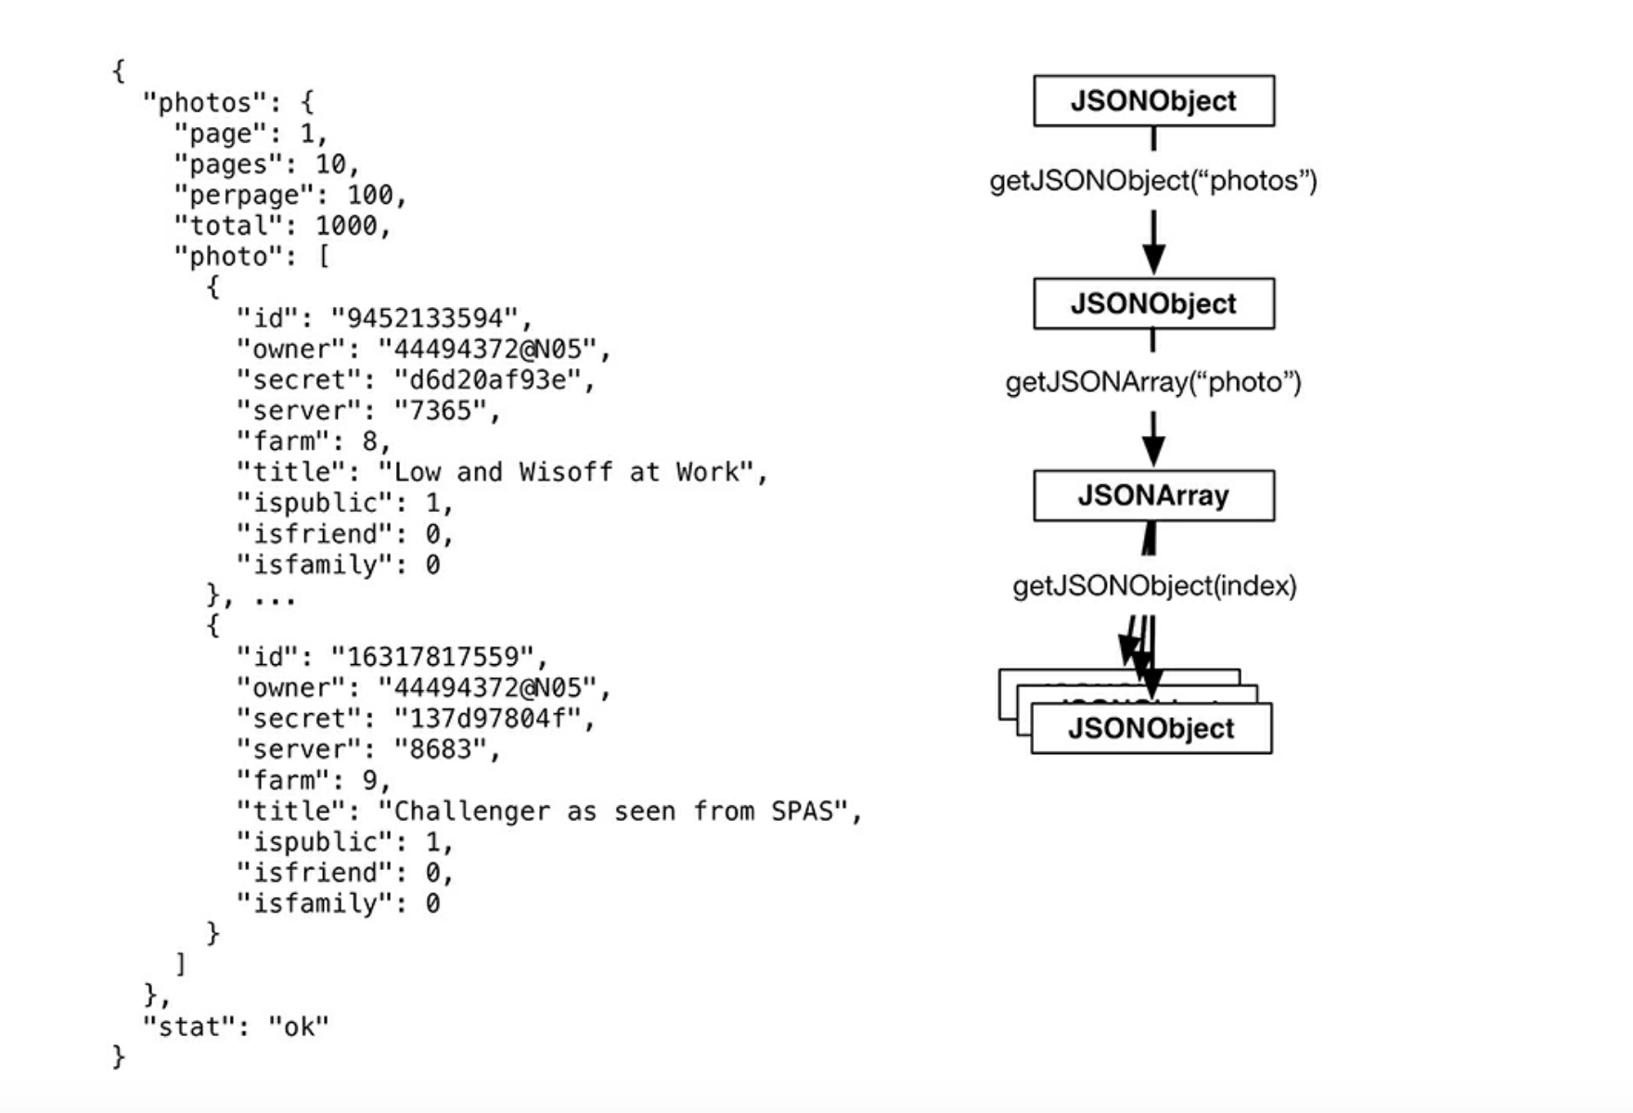

Slide 20
Parse JSON
﻿A JSON object is a set of name-value pairs enclosed between curly braces, { }. A JSON array is a comma-separated list of JSON objects enclosed in square brackets, [ ]. You can have objects nested within each other, resulting in a hierarchy. The org.json API provides Java objects corresponding to JSON text, such as JSONObject and JSONArray. You can easily parse JSON text into corresponding Java objects using the JSONObject(String) constructor.
﻿The JSONObject constructor parses the JSON string you passed it, resulting in an object hierarchy that maps to the original JSON text. The object hierarchy for the JSON returned from Flickr is shown in Figure 25.11. Here you have a top-level JSONObject that maps to the outermost curly braces in the original JSON text. This top-level object contains a nested JSONObject named photos. Within this nested JSONObject is a JSONArray named photo.
This array contains a collection of JSONObjects, each representing metadata for a single photo. Write a method that pulls out information for each photo. Make a GalleryItem for each photo and add it to a List.

Slide 21
Parse JSON
﻿This code uses convenience methods such as getJSONObject(String name) and getJSONArray(String name) to navigate the JSONObject hierarchy. (These methods are also annotated in Figure 25.11.) Flickr does not always return a url_s component for each image. You add a check here to ignore images that do not have an image URL. The parseItems(…) method needs a List and JSONObject. Update fetchItems() to call parseItems(…) and return a List of GalleryItems.
.

Slide 22
Updating Main UI Thread
﻿However, now that you are using an AsyncTask you are triggering some callbacks from a background thread. Thus you cannot assume that the fragment is attached to an activity. You must check to make sure that your fragment is still attached. If it is not, then operations that rely on that activity (like creating your PhotoAdapter, which in turn creates a TextView using the hosting activity as the context) will fail. This is why, in your code above, you check that isAdded() is true before setting the adapter.

Slide 23
Updating Main UI Thread
Now you need to call setupAdapter() after data has been fetched from Flickr.
On a computer, this toe-stepping-on results in objects in memory becoming corrupted. Because of this, you are not allowed to update the UI from a background thread, nor is it safe or advisable to do so. What to do? AsyncTask has another method you can override called onPostExecute(…). onPostExecute(…) is run after doInBackground(…) completes.
More importantly, onPostExecute(…) is run on the main thread, not the background thread, so it is safe to update the UI within it. Modify FetchItemsTask to update mItems and call setupAdapter() after fetching your photos to update the RecyclerView’s data source.

Slide 24
Background Services and intents

Slide 25
Intent Filters
Intents are used to signal to the Android system that a certain event has occurred.
Intents often describe the action which should be performed and provide data upon which such an action should be done.
A component can register itself via an intent filter for a specific action and specific data.
An intent filter specifies the types of intents to which an activity, service, or broadcast receiver can respond to by declaring the capabilities of a component.

Slide 26
Intent Filters
Android components register intent filters either statically in the AndroidManifest.xml or dynamically in code.
An intent filter is defined by its category, action, and data filters.
It can also contain additional meta-data.
The Android OS determines which component to start based on the information provided by intents.

Slide 27
Intent Contents
Component name
  The name of the component to start.
Action
  A string that specifies some generic action to perform
Data
  The directed or used by intended component (e.g. URI)
Category
  A string containing additional information about the kind of component that should handle the intent.
Extras
  Key-value pairs that carry additional information to perform action (you’ve already used an example of this)
Flags
  Function as meta-data for the intent

Slide 28
Component Name
The name of the component to start. This is optional, but it's the critical piece of information that makes an intent explicit, meaning that the intent should be delivered only to the app component defined by the component name.
Without a component name, the intent is implicit and the system decides which component should receive the intent based on the other intent information (such as the action, data, and category).
If you need to start a specific component in your app, you should specify the component name.

Slide 29
Intent Action
A string that specifies the generic action to perform (such as view or pick).
You can specify your own actions for use by intents within your app (or for use by other apps to invoke components in your app)
But you should usually use action constants defined by the Intent class.

Slide 30
Intent Action
ACTION_VIEW Use this action in an intent with startActivity() when you have some information that an activity can show to the user, such as a photo to view in a gallery app, or an address to view in a map app.
ACTION_SEND Also known as the "share" intent, you should use this in an intent with startActivity() when you have some data that the user can share through another app, such as an email app or social sharing app.

Slide 31
Implicit Intent
An implicit intent specifies an action that can invoke any app on the device able to perform the action.
Using an implicit intent is useful when your app cannot perform the action, but other apps probably can and you'd like the user to pick which app to use.
For example, if you have content you want the user to share with other people, create an intent with the ACTION_SEND action and add extras that specify the content to share. When you call startActivity() with that intent, the user can pick an app through which to share the content.

Slide 32
Intent Action
You can specify the action for an intent with setAction() or with an Intent constructor.

Slide 33
Intent Data
The URI (a Uri object) that references the data to be acted on and/or the MIME type of that data. The type of data supplied is generally dictated by the intent's action.
  For example, if the action is ACTION_EDIT, the data should contain the URI of the document to edit.
When creating an intent, it's often important to specify the type of data (its MIME type) in addition to its URI.
  For example, an activity that's able to display images probably won't be able to play an audio file, even though the URI formats could be similar.
  Specifying the MIME type of your data helps the Android system find the best component to receive your intent.
However, the MIME type can sometimes be inferred from the URI—particularly when the data is a content: URI. A content: URI indicates the data is located on the device and controlled by aContentProvider, which makes the data MIME type visible to the system.
To set only the data URI, call setData(). To set only the MIME type, call setType(). If necessary, you can set both explicitly with setDataAndType().

Slide 34
Intent Catergories
A string containing additional information about the kind of component that should handle the intent.
Any number of category descriptions can be placed in an intent, but most intents do not require a category. the full list of categories.
You can specify a category with addCategory().
These properties listed above (component name, action, data, and category) represent the defining characteristics of an intent. By reading these properties, the Android system is able to resolve which app component it should start. However, an intent can carry additional information that does not affect how it is resolved to an app component. An intent can also supply the following information:

Slide 35
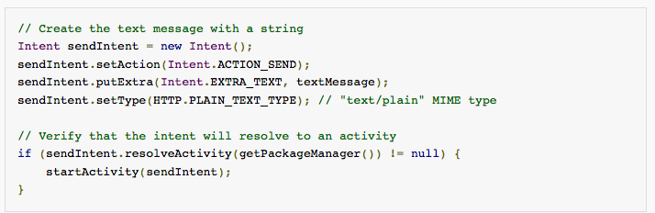
In Code Implicit Intent Filter

Slide 36
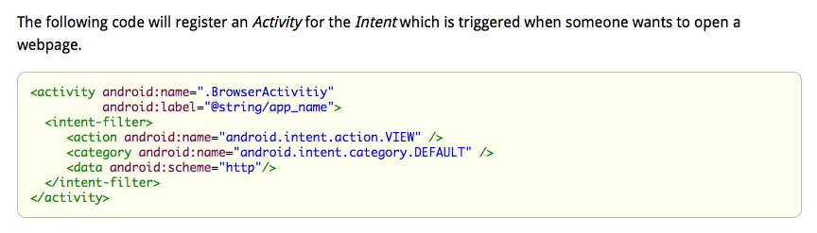
AndroidManifest Intent Filters

Slide 37
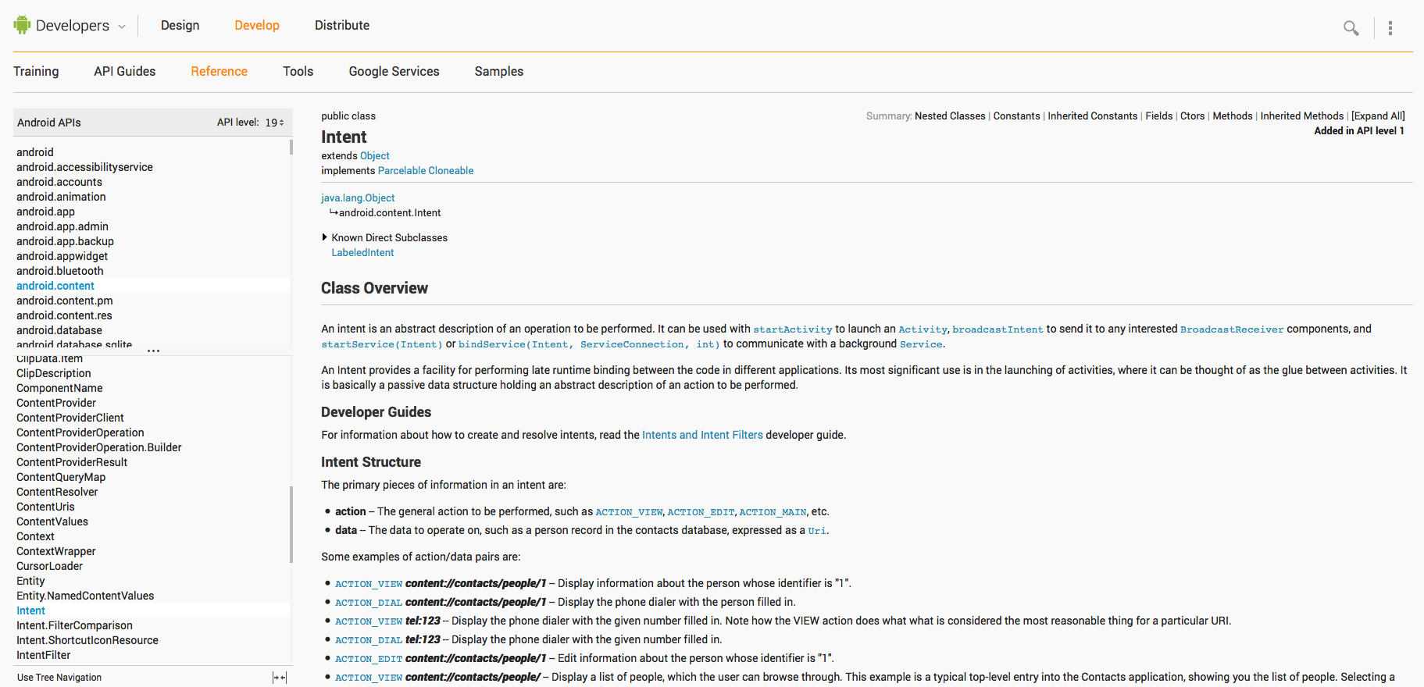
Tip of the Iceberg

Slide 38
PackageManager Class
What if you are creating implicit intents and the device does not have any matching activities?
If the OS can not find a matching activity then your app will force close.
Solution is to use the Android OS PackageManager class.

Slide 39
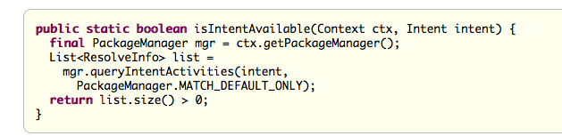
PackageManager
Class for retrieving various kinds of information related to the application packages that are currently installed on the device.
You can find this class through getPackageManager().

Slide 40
PackageManager in Action
You pass your intent into the PackageManager’s queryIntentActivities(…) method.
See Android Studio example

Slide 41
What Is a Service?
A service is an Android component which runs in the background without direct interaction with the user.
  It does not follow the lifecycle of an activity.
Services are used for repetitive and potentially long running operations, i.e., Internet downloads, checking for new data, data processing, updating content providers and the like.
Services run with a higher priority than inactive or invisible activities and therefore it is less likely that the Android system terminates them.

Slide 42
Services and Background Processes
By default a service runs in the same process as the main thread of the application.
You need to use asynchronous processing in the service to perform resource intensive tasks in the background.
  run a new Thread() in the service to perform the processing in the background
  then to terminate the service once it has finished the processing

Slide 43
IntentService
The IntentService class provides a straightforward structure for running an operation on a single background thread.
However IntentService has some limitations
  It can't interact directly with your user interface. To put its results in the UI, you have to send them to an Activity.
  Work requests run sequentially. If an operation is running in an IntentService, and you send it another request, the request waits until the first operation is finished.
  An operation running on an IntentService can't be interrupted.
However, in most cases an IntentService is the preferred way to simplify background operations.

Slide 44
Create an IntentService
To create an IntentService component for your app, define a class that extends IntentService, and within it, define a method that overrides onHandleIntent().
  This subclass of IntentService will be called “PollService”
onHandleIntent(Intent) is the required callback method for IntentService and you must implement in your applications.
See code Listing 29.1

Slide 45
Create an IntentService Con’t
The required callback methods responds to intents.
A service’s Intents are called commands.
  Instructions the service is supposed to follow
This Intent can optionally contain data for the IntentService to process.
You can send an Intent to an IntentService from any point in an Activity or Fragment.

Slide 46
Work Queue
An IntentService services commands off of a queue.
When it receives its first command, the IntentService starts up, fires up a background thread, and puts the command on a queue.
The IntentService then proceeds to service each command in sequence, calling onHandleIntent(Intent) on its background thread for each command.
New commands that come in go to the back of the queue.
When there are no commands left in the queue, the service stops and is destroyed.

Slide 47
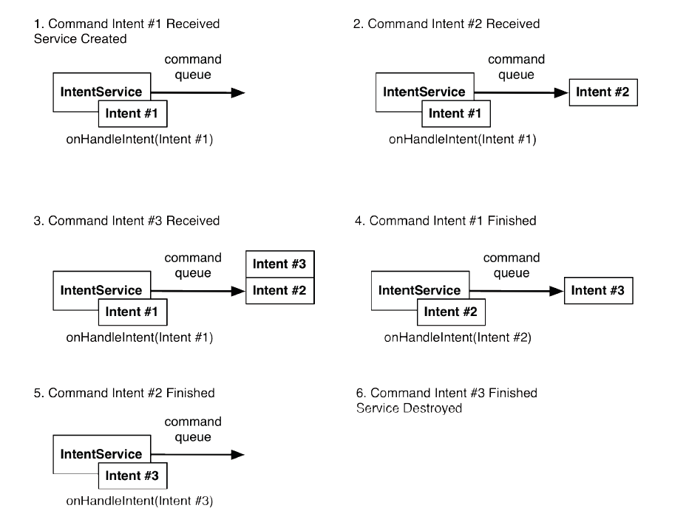
How IntentService services commands

Slide 48
Services and AndroidManifest.xml
The Android OS must notified about services in your application in the same manner its notified about Activities.
An entry must be added to the AndroidManifest.xml file.
Provide an entry as a <service> element that's a child of the <application> element:
Notice that the <service> element doesn't contain an intent filter.
The Activity that sends work requests to the service uses an explicit Intent, so no filter is needed.
This also means that only components in the same app or other applications with the same user ID can access the service.

Slide 49
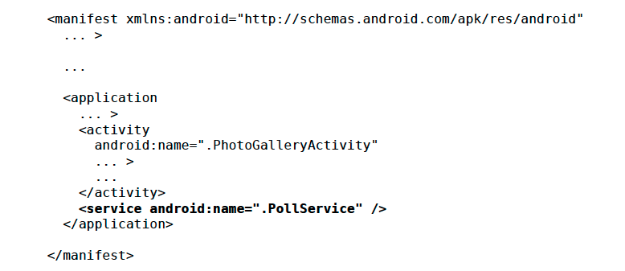
Add service to manifest (AndroidManifest.xml)

Slide 50
Start the Service
Notice that you can send the work request from anywhere in an Activity or Fragment.
  For example, if you need to get user input first, you can send the request from a callback that responds to a button click or similar gesture.
Once you call startService(), the IntentService does the work defined in its onHandleIntent() method, and then stops itself.

Slide 51
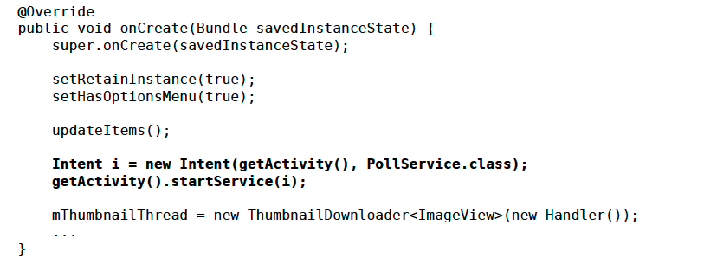
Listing 29.3 Add service startup code (PhotoGalleryFragment.java)

Slide 52
IntentService vs Service
Service is a base class of service implementation.
Service class is run in the application's main thread which may reduce the application performance.
IntentService, which is a direct subclass of Service and is used to perform a certain task in the background.

Slide 53
When to Use (via stackoverflow)
The Service can be used in tasks with no UI, but shouldn't be too long. If you need to perform long tasks, you must use threads within Service.
The IntentService can be used in long tasks usually with no communication to Main Thread. If communication is required, can use Main Thread handler or broadcast intents. Another case of use is when callbacks are needed (Intent triggered tasks).

Slide 54
How to Trigger
The Service is triggered calling to method onStartService().
The IntentService is triggered using an Intent, it spawns a new worker thread and the method onHandleIntent() is called on this thread.

Slide 55
Trigger From
The Service may be triggered from any thread.
The IntentService must be triggered from Main Thread.

Slide 56
Runs On
The Service runs in background but it runs on the Main Thread of the application.
The IntentService runs on a separate worker thread.

Slide 57
Limitations
The Service may block the Main Thread of the application.
The IntentService cannot run tasks in parallel. Hence all the consecutive intents will go into the message queue for the worker thread and will execute sequentially.

